Slide 1
SageMaker L200 Deep Dive Deck
Comprehensive
Notes:
1/I am going to talk about how Amazon SageMaker helps you to accelerate innovation using machine learning.

Slide 2
Agenda
Overview of Amazon SageMaker
No-code ML tools
Integrated ML tools in a single interface
Session I – SageMaker for Feature Engineering
SageMaker Data Wrangler
SageMaker Processing
SageMaker Feature Store
Session II – SageMaker Building ML models
Session III – SageMaker Training Deep Dive
SageMaker HPO
Spot Training
SageMaker Debugger
Distributed Training
Session IV – SageMaker Hosting Deep Dive
SageMaker Inference
Autoscaling
SageMaker Batch Transform
Async Inference
SageMaker Inference Pipelines
SageMaker Multi-model Endpoints
SageMaker Model Monitoring
Session V – SageMaker for MLOps
SageMaker Pipelines
SageMaker Model Registry
SageMaker Projects
2

Slide 3
Overview of Amazon SageMaker
Notes:
Purpose-built tools to preparing data for ML

Slide 4
Business analysts
Make ML predictions using a visual interface with Amazon SageMaker Canvas
Data scientists
Prepare data and build, train, and deploy ML models with Amazon SageMaker Studio
Amazon SageMaker
Infrastructure, tools, visual interfaces, workflows, orchestration, and collaboration
Amazon SageMaker helps organizations harness ML
MLOps engineers
Deploy and manage models at scale with Amazon SageMaker MLOps
Notes:
1/Amazon SageMaker is a comprehensive machine learning service enabling business analysts, data scientists, and MLOps engineers to build, train, and deploy ML models for any use case, regardless of ML expertise.
2/Business analysts can make ML predictions using a visual interface with SageMaker Canvas.
3/Data scientist can easily prepare data, and build, train, and deploy ML models with SageMaker Studio.
4/MLOps engineers can deploy and manage models at scale with SageMaker MLOps.
Transition: But customers face some challenges as they build, train, and deploy ML models.

Slide 5
Overcoming the barriers to ML
No-code ML tools
Make ML predictions regardless of ML experience
Not enough ML builders
Purpose-built data preparation tools
Label and prepare data for ML
Processing and labeling massive volumes of data for ML
Integrated ML tools in a single interface
Build, train, and deploy models using IDEs
Disparate data science tools
Tedious, manual ML operations
Built-in MLOps capabilities
Implement MLOps practices to streamline the ML lifecycle
Notes:
This reminds me of the time, when I started with my machine learning journey back in 2014 and up until early 2019 before I started using Amazon SageMaker. I used to build models on a Virtual machine, although the models that I was using at the time were not that big, but we used to have huge amount of data, and I often used to run into out of memory errors, which used to take lot of time to resolve, setting up clusters, writing data distribution scripts, plus in order to optimize the hyperparameters of the model, I had to keep track of the hundreds of experiments that I was running, moreover, once the models were trained, deployment was a nightmare, where I had to work for days with the DevOps team, before I could focus on solving the next business problem. So, SageMaker, helped me with overcoming lot of these challenges. We are going to talk about SageMaker features in today’s session.
But before we do a deep dive on SageMaker features,
Customers tell us there are four main challenges:
1/First, there are not enough people with ML expertise to meet the growing demand for building with ML. SageMaker provides no-code ML tools including Amazon Canvas to enable business analysts to leverage machine learning without any ML expertise.
2/Data fuels ML. But the data needs to be labeled and prepared in large volumes before it can be used for training ML models. This requires massive data processing capabilities. SageMaker Ground Truth and SageMaker Data Wrangler make it easy to label and prepare data for ML.
3/There is a proliferation of data science tools that are difficult to integrate, siloed by each part of the ML lifecycle. SageMaker brings together purpose-built tools for every step of the ML lifecycle under the SageMaker Studio integrated development environment, making it easy to build, train, and deploy ML models.
4/DevOps teams have to manually manage disparate environments for prototyping, development, testing, validation, and production, making it difficult maintain consistency across these environments and ultimately delaying deployment of models to production. SageMaker provides MLOps capabilities, including SageMaker Pipelines, SageMaker Projects, and SageMaker Model Registry to help you streamline ML lifecycle, reducing the operational burden of managing ML models in production and accelerating the time to value.
Transition: Let’s look closely at each of these four components of SageMaker.

Slide 6
No-code ML tools
Notes:
First, let’s look at no-code tools for non-ML experts to leverage machine learning in their daily work to solve problems.

Slide 7
Quickly access and prepare data sources for ML
Amazon SageMaker Canvas Generate ML predictions – no code required
AutoML built in to generate accurate predictions
Share ML models with data science teams
Notes:
1/Amazon SageMaker Canvas makes it easy for business analysts to generate highly accurate ML predictions on their own without any ML experience.
2/With SageMaker Canvas, business analysts can easily access and import data from the cloud and on-premises data sources and quickly combine and cleanse data.
3/From there, Canvas generates an ML model automatically.
4/Business analysts can use SageMaker Studio to share the model with data scientists in their organization to get feedback.
Transition: Let’s dive into the next component of SageMaker.

Slide 8
Support the responsible use of ML throughout the model lifecycle
Build
Perform bias analysis during exploratory data analysis
Train
Conduct bias and explainability analysis after training
Deploy
Explain individual inferences from models in production
Monitor
Validate bias and relative feature importance over time
Notes:
1/Amazon SageMaker Clarify provides greater visibility into their training data and models so you can identify and limit bias and explain predictions.
2/Amazon SageMaker Clarify detects potential bias during data preparation, after model training, and in your deployed model by examining attributes you specify. For instance, you can check for bias related to age in your initial dataset or in your trained model and receive a detailed report that quantifies different types of possible bias. SageMaker Clarify also includes feature importance graphs that help you explain model predictions and produces reports which can be used to support internal presentations or to identify issues with your model that you can take steps to correct.
3/Amazon SageMaker Clarify is integrated with SageMaker Model Monitor, enabling you to configure alerting systems like Amazon CloudWatch to notify you if your model exceeds certain bias metric thresholds.
3/And it all works within Amazon SageMaker Studio and integrates with other Amazon SageMaker tools throughout the process of building a model.

Slide 9
Integrated ML tools in a single interface
Notes:
Amazon SageMaker helps data scientists and developers to build, train, and deploy ML models quickly by bringing together a broad set of purpose-built ML capabilities under single pane of glass.

Slide 10
Amazon SageMaker brings tools for every step of the ML lifecycle under one unified visual user interface
SageMaker Studio | RSTudio
Label data
Prepare data
Store features
Detect bias
Build with notebooks
Train models
Tune parameters
Deploy in production
Explain predictions
Manage and monitor
Manage edge devices
Notes:
1/ Amazon SageMaker Studio is the first fully integrated development environment designed specifically for ML that brings everything you need for ML under one unified, visual user interface. From a web-based visual interface you can perform all ML development steps required to prepare data, and build, train, and deploy ML models.
2/Using Amazon SageMaker Studio’s integrated capabilities for machine learning, you can eliminate months of writing custom integration code, and ultimately reduce cost.
3/You have access to purpose-built tools for every step of ML development, including labeling, data preparation, feature engineering, statistical bias detection, auto-ML, training, tuning, hosting, explainability, monitoring, and workflows.
4/You can write code, track experiments, visualize data, and perform debugging and monitoring all within a single environment. In addition, since all these steps of the ML workflow are tracked within the environment, you can quickly move back and forth between steps, and also clone, tweak and replay them. This gives you the ability to make changes quickly, observe outcomes, and iterate faster, reducing the time to market for high quality ML applications.
5/You can also analyze and visualize data for ML in the R language with elastic compute resources in RStudio on SageMaker, the first fully managed RStudio Workbench in the cloud.
Transition: Let’s dive into the capabilities and benefits of Amazon SageMaker for building, training, and deploying ML models.

Slide 11
Amazon SageMaker
Studio Notebook
Perform data engineering, analytics, and ML workflows in one notebook
Connect with Amazon EMR, Amazon S3, and more
Interactively access, transform, and analyze a wide range of data
Build, train, and deploy models using your preferred framework
Notes:
1/You can now use Amazon SageMaker Studio to do data processing, analytics, and machine learning workflows in one unified notebook. Just like you can write many different documents from one word processing program, from this universal notebook, you can access a wide a rang of data sources and write code for any transformation for a variety of data workloads.
2/SageMaker Studio Notebooks has built-in integration with Spark, Hive, and Presto running on Amazon EMR clusters and data lakes running on S3 with support for additional data sources coming in early 2022, so you can access and manipulate data without switching services.
3/You can browse and query data sources, explore metadata and schemas, and start processing jobs for analytics or machine learning workflows. You can code using you preferred framework to build, train, and deploy machine learning models— all without leaving the universal Amazon SageMaker Studio notebook.
Transition: Let’s now explore the capabilities and benefits of SageMaker for training ML models.

Slide 12
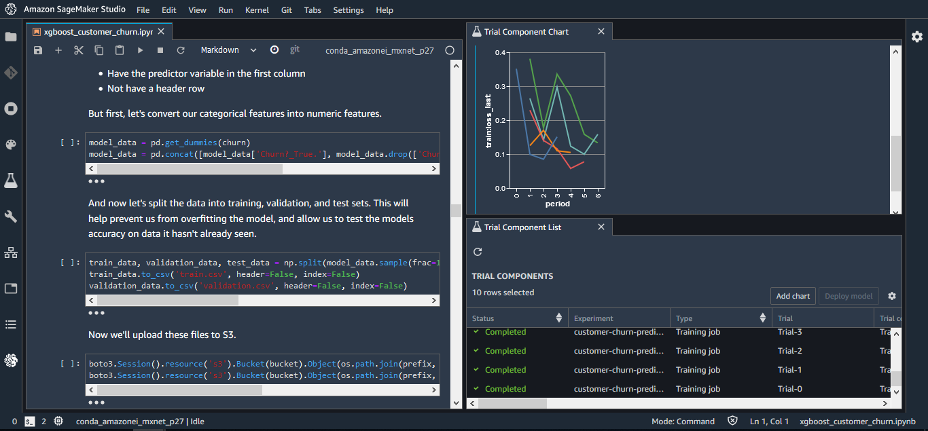
Use Amazon SageMaker Studio to update models and see impact on model quality immediately

Slide 13
Amazon SageMaker Notebooks
Fast-start sharable notebooks
Easy access with Single Sign-On (SSO)
Access your notebooks in seconds
Fully managed and secure
Administrators manage access and permissions
Fast setup
Start your notebooks without spinning up compute resources
Easy collaboration
Share notebooks with a single click
Flexible
Dial up or down compute resources (coming soon)

Slide 14
Session I
SageMaker for Feature Engineering
Notes:
Purpose-built tools to preparing data for ML

Slide 15
Structured
Unstructured
Notes:
1/There are two types of data: structured and unstructured.
2/Structured data is highly organized, quantitative data that is easily decipherable by machine learning. However, structured data makes up only a small percentage of all the data out there.
3/Unstructured data on the other hand is 80% of all data. This data is qualitative including things like images, hand-written notes, and geospatial data. It’s extremely valuable, but much harder to work with in the context of machine learning.
Transition: So we’ve spent a lot of energy on making data prep for all types of data better for our customers.

Slide 16
Single visual interface for common data prep techniques
Amazon SageMaker Data Wrangler
No-code data preparation
Select data from multiple sources
300+ built-in transformations to prepare data without writing code
Notes:
1/ We launched SageMaker Data Wrangler to easily aggregate and prepare data for machine learning without writing any code. With Data Wrangler, you can use a visual interface to access, cleanse, and explore data from a single visual interface.
2/Using SageMaker Data Wrangler’s data selection tool, you can choose the data you want from various data sources and import it with a single click.
3/SageMaker Data Wrangler contains over 300 built-in common data transformations so you can quickly normalize, transform, and combine features without having to write any code such as converting data types to a consistent format or formatting strings. With SageMaker Data Wrangler’s visualization templates, you can quickly preview and inspect that transformations are completed as you intended.
Transition: With SageMaker Data Wrangler, data scientists can easily prepare structured data for ML including model features. Features represent relevant attributes or properties that your model uses for training and to make predictions. So for example, if we look at Intuit’s TurboTax contextual help model, which tries to provide the most relevant possible tax guidance to a tax filer, features would include data about the customer’s previous interactions. Selecting which features your model will use for predictions is a high judgement call requiring data scientists to apply domain knowledge to extract features from raw data. These features are then used to train a model and used in inference, when the model is making a prediction.

Slide 17
Achieve distributed processing for clusters
Amazon SageMaker Processing Job
Bring your own script for feature engineering
Use SageMaker’s built-in containers or bring your own
Managed solution for data processing and model evaluation jobs
Leverage SageMaker’s security and compliance features
Your resources are created, configured, and terminated automatically
Notes:
For that we have SageMaker Processing job. It can be used for both structured and unstructured data.
With Processing, you can use a simplified, managed experience on SageMaker to run your data processing workloads, such as feature engineering, data validation, model evaluation, and model interpretation.
You can also use the Amazon SageMaker Processing APIs during the experimentation phase and after the code is deployed in production to evaluate performance.
If you have large amount of data, it can help you to perform distributed processing of data as well.
You can bring your own script for feature engineering, and choose if you want to use built in containers provided by AWS or bring your own containers.
Currently, for processing the built-in containers include Sklearn and PySpark and Framework processors.
A FrameworkProcessor can run Processing jobs with a specified machine learning framework, providing you with an Amazon SageMaker–managed container for whichever machine learning framework you choose.
FrameworkProcessor provides pre-made containers for the Hugging Face, MXNet, PyTorch, TensorFlow, and XGBoost, machine learning frameworks.
All the resources which are created as part of running the processing job are, configured and terminated automatically, so you pay only for the amount of time that processing job was running.
Transition: Let’s see how would you, configure and run SageMaker processing job.

Slide 18


Data Processing on Amazon SageMaker
Cluster
Instance 1
Instance 2
Instance N
Processing Container
/opt/ml/processing/input
s3://bucket/path/to/input_data
/opt/ml/processing/output
s3://bucket/path/to/output_data

Slide 19
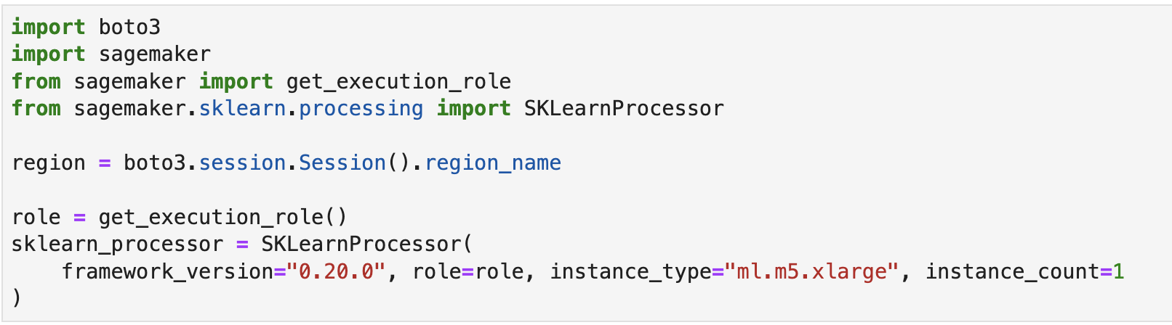
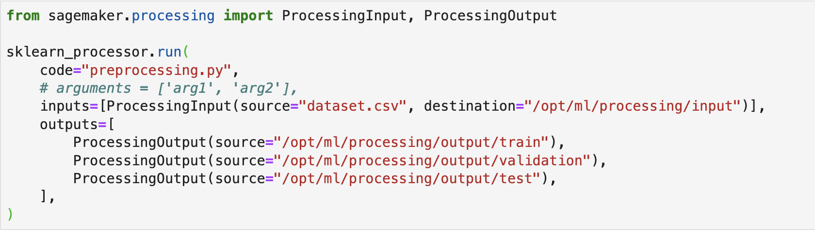
Data Processing on Amazon SageMaker
Notes:
We first need to create a Processor object, in this example we are using SKLearnProcessor, provided by Amazon SageMaker.
In the first part we define the necessary hardware resources, on which the processing job will be executed.
Lets take a look at, instance_type & instance_count, these parameters tells the processing job, to launch one machine in the cloud of type ml.m5.xlarge in case. If instance_count > 1, then it will automatically create a cluster for you.
Next we need an environment on which our processing scrip will be executed, since we are using sklearnProcessor, we define the framework version of sklearn needed for our job, in this case, after launching the instance, it will launch a sklearn container with framework, 0.20.0.
In the second part, we provide the processing script, and input location of our data. Your input data must be stored in an Amazon S3 bucket. Alternatively, you can use Amazon Athena or Amazon Redshift as input sources.
It will then automatically copy the data from s3 to the destination path, which is the path on local to the container.
Once, the job completes, the output of the Processing job is stored in the Amazon S3 bucket you specified, if you don’t provide the destination path, then it will store to the default s3 location.
Cluster resources are provisioned for the duration of your job, and cleaned up when a job completes, so you only pay for the amount of time the job is running.
So far, we have seen how you process data using data wrangler and SageMaker processing jobs.

Slide 20
80% of time spent on data prep
What data scientists spend the most time doing
Source: Forbes survey of 80 data scientists, March 2016
Notes:
And we learned that, Data processing is a time and resource intensive process, due to the inherent nature of data being dirty and not ready for Machine Learning in its raw form. Dirty data could include missing or errorneous values, outlier etc.
how do we minimize the cost and the time spent on running the processing jobs over and over again?
What if there is a way to store the processed features in a central location such that they are consistent, discoverable, and shareable with other team members. Yes, I am talking about having a feature store, which can be used for storing the processed features, which can then be used for training and inference on machine learning models.

Slide 21
Feature drift
Challenges of separate feature stores
Feature duplication
Slow model development/deployment
Notes:
1/Previously, Intuit was storing these features for batch training in one data store and the real-time features in another. This separation between online and offline feature stores created a feature drift causing data management and inaccurate predictions problem. It required months of coding and deep expertise to keep features consistent across training and development environments. This led to feature duplication and slow model development/deployment
2/In addition, Intuit had multiple teams creating related features at the same time, and wanted to be able to share them since a strong feature for one team may provide a boost to a problem being addressed by another team. For example, a particularly strong indicator of whether or not someone needs help itemizing deductions created by one team, may be useful to another team doing XYZ.
3/So Intuit came to AWS with this challenge and together we worked backwards from the problem to build a specially-designed feature store, which served as a training repository for features where latency isn’t as important, and also provide access to the exact same features at run time where latency is important. With this feature store, Intuit was able to make its training and prediction platforms consistent with each other, ultimately creating a marketplace for feature discoverability and re-use, accelerating the model development lifecycle and improving data worker productivity.
4/But of course, most organizations do not have the resources to create a specially-designed feature store and it can take months to do.

Slide 22
Online and off-line
Millisecond latency
Amazon SageMaker Feature Store
Securely store, discover, and share features for ML
Consistent features
Visual search
Sharing and collaboration
Notes:
1/ All features created in Amazon SageMaker Data Wrangler can be stored in Amazon SageMaker Feature Store with a single click, and it’s easy to update existing features or create new features.
2/ Amazon SageMaker Feature Store serves features in large batches for model training and also serves features with single digit millisecond latency for inference at run time.
3/Because SageMaker Feature Store offers a central repository for model features, you have a consistent view of your features, in other words the exact same features are available for training and inference, so your features never get out of sync between training and inference.
4/You can visually search and discover features in SageMaker Studio.
5/All members of your team can share features into the repository promoting reuse and eliminating rework. Feature Store also offers a unified set of features definitions across teams making it easier for teams to work together.
Transition: With SageMaker Data Wrangler and SageMaker Feature Store, data scientists can easily prepare structured data for ML. Now let’s look at unstructured data.

Slide 23
Session II
SageMaker Building ML models

Slide 24
Fully managed, sharable Jupyter notebooks
Run notebooks on elastic compute resources
Built-in algorithms
15 built-in algorithms available in prebuilt container images
Build ML models
Fully managed shareable notebooks on Amazon EC2
Prebuilt solutions and open-source models
Over 150 popular open-source models
AutoML
Automatically create ML models with full visibility
Support for major frameworks and toolkits
Optimized for popular deep learning (DL) frameworks such as TensorFlow, PyTorch, Apache MXNet, and Hugging Face
24
Notes:
1/Amazon SageMaker Studio provides all the tools you need to iteratively try different modeling techniques in order to evaluate their performance. You can pick different algorithms, including over 15 that are built in and optimized for SageMaker, and over 150 pre-built models from popular model zoos available with just a few clicks. Inside SageMaker Studio, you can run the models on a small scale to see results and view reports on their performance so you can come up with high-quality working prototypes.
2/The key capabilities for building ML models are:
Fully managed Jupyter Notebooks
Amazon SageMaker Studio Notebooks are fully managed Jupyter notebooks and the underlying compute resources are fully elastic, so you can easily dial up or down the available resources. Notebooks are shared with a single click so colleagues get the same notebook, saved in the same place.
Built-in Algorithms
Amazon SageMaker also offers over 15 built-in algorithms available in pre-built container images that can be used to quickly train and run inference. Some example algorithms include, DeepAR, K-Means Clustering, Linear Learn, K-Nearest Neighbor, and BlazingText.
Pre-Built Solutions and Open-Source Models
Amazon SageMaker JumpStart helps you quickly get started with ML using pre-built solutions that can be deployed with just a few clicks. SageMaker JumpStart also supports one-click deployment and fine-tuning of more than 150 popular open-source models.
AutoML
Amazon SageMaker Autopilot automatically builds, trains, and tunes the best machine learning models, based on your data while allowing to maintain full control and visibility. You then can directly deploy the model to production with just one click, or iterate to improve the model quality. Amazon SageMaker Autopilot eliminates the heavy lifting of building ML models, and helps you automatically build, train, and tune the best ML model based on your data. With SageMaker Autopilot, you simply provide a tabular dataset and select the target column to predict, which can be a number (such as a house price, called regression), or a category (such as spam/not spam, called classification). SageMaker Autopilot will automatically explore different solutions to find the best model. You then can directly deploy the model to production with just one click, or iterate on the recommended solutions with Amazon SageMaker Studio to further improve the model quality.
Optimized for Major Frameworks
Amazon SageMaker is optimized for many popular deep learning frameworks such as TensorFlow, Apache MXNet, PyTorch, and more. Frameworks are always up-to-date with the latest version, and are optimized for performance on AWS. You don’t need to manually setup these frameworks and can use them within the built-in containers.
Transition: Today, data scientists use SageMaker Studio to quickly spin up a Notebook in SageMaker Studio to build machine learning models. But, customers tell us that to get the most value from their data they often need to manage separate analytic and data preparation notebooks to perform data engineering and data analytics as well as for building machine learning models. And increasingly, the functions of data engineering, data analytics, and data science are blurring, either being performed by the same person or often needing access to the same tool sets. For instance, both an engineer and a scientist need to run some Spark workloads, be it for pre-processing or feature engineering or data exploration or perhaps even model building. The context switching and set up of different interfaces is complex and slows down innovation. To solve this, customers asked us for one notebook to cover all of their data needs.

Slide 25
Amazon SageMaker has built-in algorithms or bring your own
Classification
Linear Learner | XGBoost | KNN
Computer vision
Image classification | Object detection | Semantic segmentation
Topic modeling
LDA | NTM
Working with text
BlazingText | Supervised | Unsupervised
Recommendation
Factorization machines
Forecasting
DeepAR
Sequence translation
Seq2Seq
Regression
Linear Learner | XGBoost | KNN
Clustering
KMeans
Anomaly detection
Random cut forests | IP Insights
Feature reduction
PCA
25
Notes:
Amazon SageMaker comes with dozens of pre-build algorithms. Amazon SageMaker provides high-performance, scalable machine learning algorithms, optimized for speed, scale, and accuracy, that can perform training on petabyte-scale data sets. Amazon SageMaker includes supervised algorithms such as XGBoost and linear/logistic regression or classification, to address recommendation and time series prediction problems. Amazon SageMaker also includes support for unsupervised learning (i.e. the algorithms must discover the correct answers on their own), such as with k-means clustering and principal component analysis (PCA), to solve problems like identifying customer groupings based on purchasing behavior.

Slide 26
Session III
SageMaker Training Deep Dive

Slide 27
Experiment management and model tuning
Save weeks of effort by automatically tracking training runs and tuning hyperparameters
Debug and profile training runs
Use real-time metrics to correct performance problems
Train ML models
Fast and cost-effective ML model training
Distributed training
Complete distributed training up to 40% faster
Training compiler
Accelerate training times by up to 50% through more efficient use of GPUs
Managed spot training
Reduce the costs of training by up to 90%
Notes:
1/ Amazon SageMaker reduces the time and cost to train and tune machine learning (ML) models without the need to manage infrastructure.
2/With Amazon SageMaker, you can easily train and tune ML models using purpose-built tools to manage and track training experiments, automatically choose the optimal hyperparameters, debug training jobs, and automatically monitor utilization of system resources such as GPUs, CPUs, and network bandwidth. All steps of the training workflow can be automated into ML workflow so you can scale to thousands of training experiments. SageMaker also offers the highest performing ML compute infrastructure including P4d instances which provide up to 60% lower cost to train ML models compared to previous generation instances. SageMaker automatically scales infrastructure up and down based on your training job requirements from one GPU to thousands, or from terabytes to petabytes of storage. Therefore, you don’t need to worry about managing infrastructure, and since you only pay for what you use, you can better manage your training costs. To making traing faster, you can enable the SageMaker Training Compiler and immediately achieve up to 50% speed up through graph and kernel level optimizations which makes more efficient use of GPUs. Also, the SageMaker distributed training libraries automatically split models and training datasets across GPU instances helping you complete distributed training up to 40% faster.
3/They key capabilities to train ML models are:
Experiment Management and Automatic Model Tuning
Amazon SageMaker Experiments helps you track iterations to ML models by capturing the input parameters, configurations, and results, and storing them as ‘experiments’. SageMaker can automatically tune your model by adjusting thousands of combinations of algorithm parameters to arrive at the most accurate predictions the model is capable of producing saving weeks of effort.
Debug and Profile Training Runs
Amazon SageMaker Debugger captures metrics and profiles training jobs in real-time so you can correct performance problems quickly before the model is deployed to production
Distributed Training
Amazon SageMaker makes it faster to perform distributed training by automatically splitting deep learning models and training datasets across AWS GPU instances with fewer than 10 lines of code.
Training Compiler
Amazon SageMaker Training Compiler accelerates training by up to 50% through graph and kernel level optimizations that make more efficient use of GPUs. It is integrated with the versions of TensorFlow and PyTorch in SageMaker so that you can speed up training in these popular frameworks with minimal code changes
Managed Spot Training
Amazon SageMaker provides Managed Spot Training to help you to reduce training costs by up to 90%. Training jobs are automatically run when compute capacity becomes available and are made resilient to interruptions caused by changes in capacity
Transition: Let’s now explore the capabilities and benefits of SageMaker for deploying ML models.

Slide 28
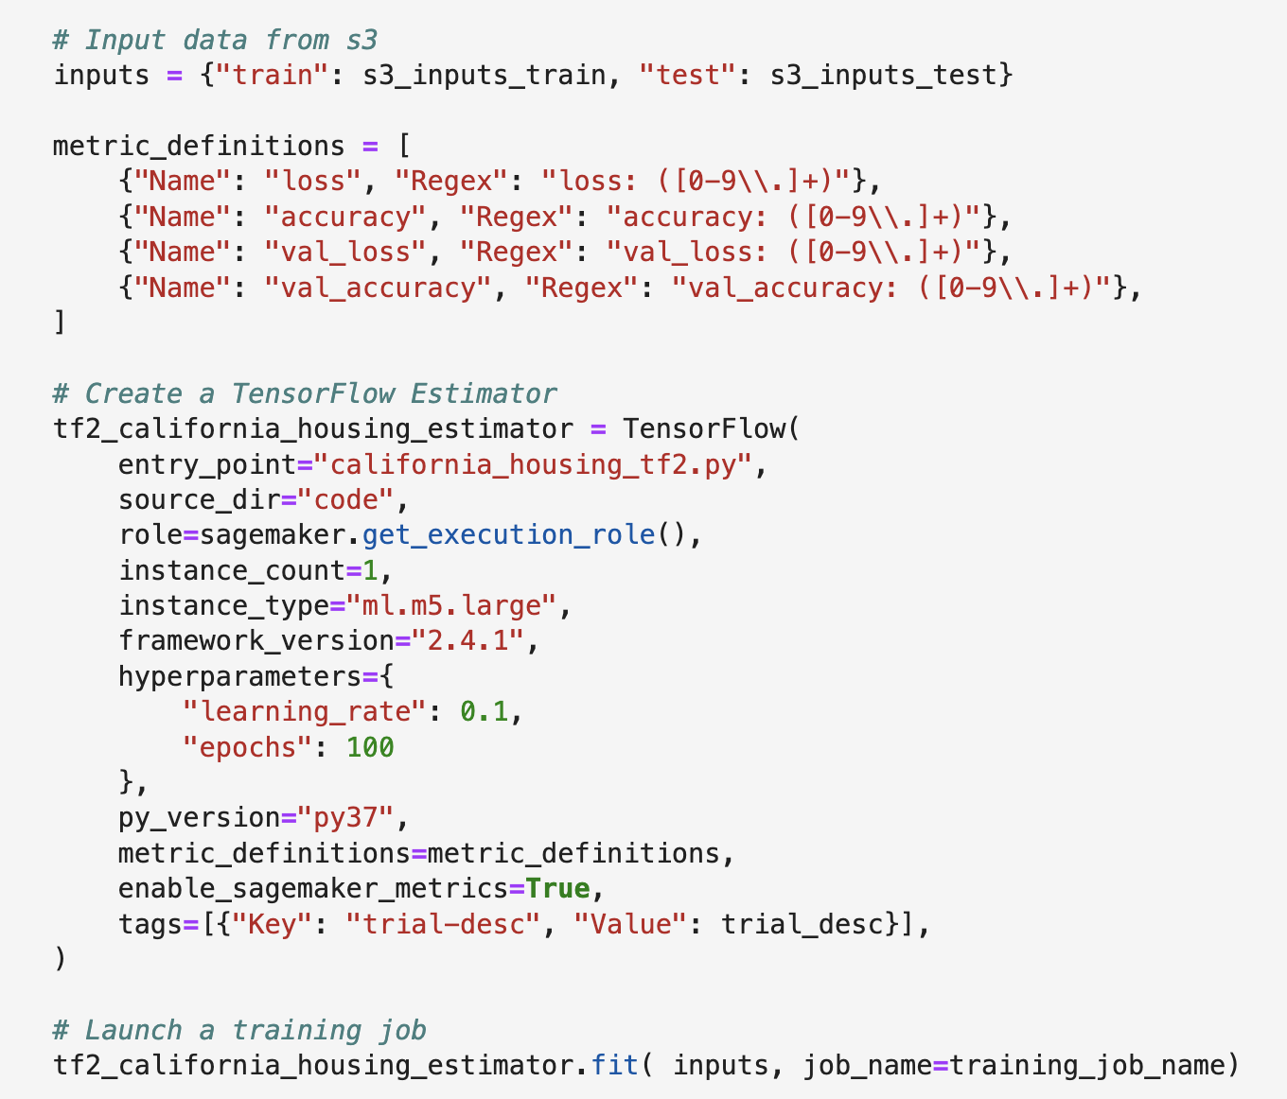







Training on Amazon SageMaker
Amazon SageMaker control plain
Data Scientist
Create training job API call
Provision/stop/ monitor instances
Storage
VPC
Amazon SageMaker Training job
Instance
Amazon FSx for Lustre
Amazon EFS
Amazon S3
Copy/stream data
Model artifacts
Models in S3
Training Code
ECR
Amazon CloudWatch
DL container: TF/PT/custom
EBS/ NVMe
Logs & metrics
Notes:
Now lets a look at what happens when you issue Training Job API. If you are familiar with SageMaker, then this is a refresher for you. If you are new to SageMaker, then this is will give you an idea about what happens behind the scene. So 1st step is DS issues a training API call. In this call, you willl supply information such as EC2 instance types, container image, EBS volumes etc as shown in the code snippet. We will look at this closely in subsequent slides. When SageMaker control plane receives this call, it is going to provision ephemeral cluster of a single ec2 or multiple EC2 instances based on your configuration. Now this means that that each training job request will have a dedicated EC2 instance. So you have few data scientists in your team or you are looking to train multiple models at once , in both situations SageMaker will spin up dedicated Ec2 instance for that training job. You no longer have to wait for the resources to be free. Now some of you might wonder well thats a problem because how do I control costs? Well there are account limits you can set which throttles the number of Ec2 instances SageMaker can spin up for your training jobs. SageMaker control plane will spin up EC2 instances, and copy your training script on these EC2 instances. It will then download the DLC image from ECR. Now in our case this is going to be the huggingface DLC. The control plain will also download your training data from the location you have specified. You can download the data from S3, EFS which is a NFS file share or FSx which is a windows file share. Once all the data is loaded, SageMaker will then start the training job. Now as soon training job completes, SageMaker will upload the trained model to S3, and write logs and metrics to Amazon CloudWatch. Now those who are not familiar with Amazon CloudWatch, Cloud watch monitors your AWS resources and its performance. Now the key thing is, as soon as the model is saved to S3, SageMaker will conclude the training job and decommission all the EC2 instances provisioned for the training job so that you are charged for only the amount of time training job was running

Slide 29
Training Estimator

Slide 30
Tuning at scale
Adjust thousands of different combinations of algorithm parameters
Amazon SageMaker Automatic Model Tuning
Automatically tune hyperparameters in your algorithms
Automated
Uses ML to find the best parameters
Faster
Eliminate days or weeks of tedious manual work
Decision trees
Tree depth | Max leaf nodes | Gamma | Eta | Lambda | Alpha
Example
Neural networks
Number of layers | Hidden layer width | Learning rate |
Embedding dimensions | Dropout
Example

Slide 31
Amazon SageMaker Automatic Model Tuning
Hyperparameter Tuning
Training Job 1
Best Model Selector
Automatic Model Tuning
Best Model
Training Job 2
Training Job N
31
Notes:
Amazon SageMaker automatic model tuning, also known as hyperparameter tuning, finds the best version of a model by running many training jobs on your dataset using the algorithm and ranges of hyperparameters that you specify. It then chooses the hyperparameter values that result in a model that performs the best, as measured by a metric that you choose.
Can be used for BIA and BYO . BIA already emits objective metrics – you just have to choose one to optimize for
You choose the hyperparameter ranges
Can run a warm start HPO job using the results of a previous job (good for when you get new data , you stopped a previous job, or you want to adjust ranges)
Jobs can run concurrently
Features:
Can stop early
Optional, but sometimes more technical audience can inquire:
Random Search
In a random search, hyperparameter tuning chooses a random combination of values from within the ranges that you specify for hyperparameters for each training job it launches. Because the choice of hyperparameter values doesn't depend on the results of previous training jobs, you can run the maximum number of concurrent training jobs without affecting the performance of the search.
Bayesian Search
Bayesian search treats hyperparameter tuning like a [regression] problem. Given a set of input features (the hyperparameters), hyperparameter tuning optimizes a model for the metric that you choose. To solve a regression problem, hyperparameter tuning makes guesses about which hyperparameter combinations are likely to get the best results, and runs training jobs to test these values. After testing the first set of hyperparameter values, hyperparameter tuning uses regression to choose the next set of hyperparameter values to test.
Hyperparameter tuning uses an Amazon SageMaker implementation of Bayesian optimization.
When choosing the best hyperparameters for the next training job, hyperparameter tuning considers everything that it knows about this problem so far. Sometimes it chooses a combination of hyperparameter values close to the combination that resulted in the best previous training job to incrementally improve performance. This allows hyperparameter tuning to exploit the best known results. Other times, it chooses a set of hyperparameter values far removed from those it has tried. This allows it to explore the range of hyperparameter values to try to find new areas that are not well understood. The explore/exploit trade-off is common in many machine learning problems.
Hyperparameter scaling:
In practice, you often have hyperparameters whose value can meaningfully span multiple orders of magnitude. If I asked you to manually try a few different step sizes for a deep learning algorithm to explore the effect of varying this hyperparameter, you would likely choose powers of 10 (such as 1.0, 0.1, 0.01, …) rather than equidistant values (such as 0.1, 0.2, 0.3, …). We know from experience that the latter is unlikely to change the behavior of the algorithm much. For many hyperparameters, changing the order of magnitude yields much more interesting variation. When selecting automatic scaling (the Auto setting), Amazon SageMaker uses log scaling or reverse logarithmic scaling whenever the appropriate choice is clear from the hyperparameter ranges. If not, it falls back to linear scaling.

Slide 32
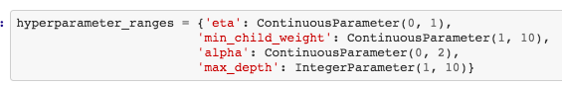
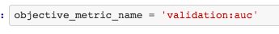
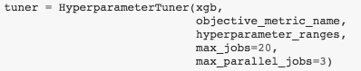
Setting up hyper parameter tuning job
1. Pick hyperparameters and ranges
2. Pick objective metric
3. Pick job parameters
Notes:
Hyperparameter tuning finds the best hyperparameter values for your model by searching over ranges of hyperparameters. You specify the hyperparameters and range of values over which to search by defining hyperparameter ranges for your tuning job
For integer and continuous hyperparameter ranges, you can choose the scale you want hyperparameter tuning to use to search the range of values by specifying a value for the ScalingType field of the hyperparameter range. You can choose from the following scaling types:
Auto - Amazon SageMaker hyperparameter tuning chooses the best scale for the hyperparameter.
Linear - Hyperparameter tuning searches the values in the hyperparameter range by using a linear scale. Typically, you choose this if the range of all values from the lowest to the highest is relatively small (within one order of magnitude), because uniformly searching values from the range will give you a reasonable exploration of the entire range.
Logarithmic - Hyperparameter tuning searches the values in the hyperparameter range by using a logarithmic scale.
Hyperparameter tuning sends an additional hyperparameter, _tuning_objective_metric to the training algorithm. This hyperparameter specifies the objective metric being used for the hyperparameter tuning job, so that your algorithm can use that information during training
By default uses bayesian search. Use strategy parameter to set random search.

Slide 33
Amazon SageMaker Automatic Model Tuning
What if I need all my jobs tuned at the same time?
Bayesian Search
Random Search
33
Notes:
In a random search, hyperparameter tuning chooses a random combination of values from within the ranges that you specify for hyperparameters for each training job it launches. Because the choice of hyperparameter values doesn't depend on the results of previous training jobs, you can run the maximum number of concurrent training jobs without affecting the performance of the search.
Bayesian search treats hyperparameter tuning like a [regression] problem. Given a set of input features (the hyperparameters), hyperparameter tuning optimizes a model for the metric that you choose. To solve a regression problem, hyperparameter tuning makes guesses about which hyperparameter combinations are likely to get the best results, and runs training jobs to test these values. After testing the first set of hyperparameter values, hyperparameter tuning uses regression to choose the next set of hyperparameter values to test.
https://docs.aws.amazon.com/sagemaker/latest/dg/automatic-model-tuning-how-it-works.html

Slide 34
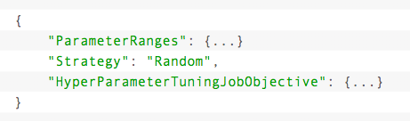
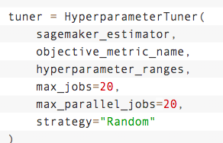
Random Search
Notes:
In a random search, hyperparameter tuning chooses a random combination of values from within the ranges that you specify for hyperparameters for each training job it launches. Because the choice of hyperparameter values doesn't depend on the results of previous training jobs, you can run the maximum number of concurrent training jobs without affecting the performance of the search.
Bayesian search treats hyperparameter tuning like a [regression] problem. Given a set of input features (the hyperparameters), hyperparameter tuning optimizes a model for the metric that you choose. To solve a regression problem, hyperparameter tuning makes guesses about which hyperparameter combinations are likely to get the best results, and runs training jobs to test these values. After testing the first set of hyperparameter values, hyperparameter tuning uses regression to choose the next set of hyperparameter values to test.
https://docs.aws.amazon.com/sagemaker/latest/dg/automatic-model-tuning-how-it-works.html

Slide 35
Amazon SageMaker Automatic Model Tuning
Can I use hyperparameter tuning with my own model?
1
2
3
Built-in Algorithms
Docker (Fully Customizable)
Script Mode (Fully Customizable)
35
Notes:
Can be used with built in and customer algorithms

Slide 36
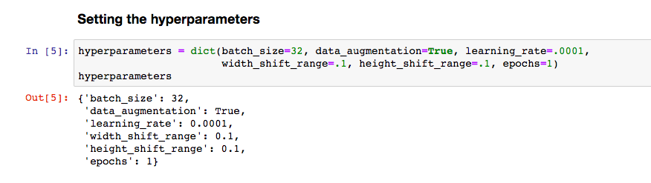
Amazon SageMaker Automatic Model Tuning
Can I use hyperparameter tuning with my own model?
Docker
Script Mode
36
Notes:
Here’s an exampe

Slide 37
Managed Spot Training

Slide 38
Enable managed spot training
Training launched with Spot-only instances
Managed Spot Training
Save up to 90% on model training costs
Spot interruption?
Yes
Wait for Spot capacity
No
Max wait time
exceeded?
Yes
Complete job
Terminate job
No
Resume from last Checkpoint
Checkpoint enabled?
Spot available
Yes
No
Restart job

Slide 39
Key considerations
Training with only Spot
Interrupted jobs resume if checkpointed and if Spot instances become available; Jobs restart if not checkpointed*
Works with Automated Model Tuning
Training jobs can run only with a single instance - type in a single - AZ
Does not integrate with Spot Fleet and Spot Block today
Checkpoint
Built-in algorithms checkpoint automatically
For custom models, checkpointing should be enabled
Checkpoints are saved to S3
Models that don’t checkpoint are subject to MaxWaitTime of 60 mins
Pricing
View savings on AWS console or use DescribeTrainingJob API
Charged for the run duration before completion or termination; not charged for idle time, billing starts when instances are ready
Charged for data download time only once even if the job is interrupted multiple times
* Checkpointing is a best practice and is highly recommended
39
Notes:
First, we provide the broadest and deepest set machine learning and AI services for your business:
AWS is unmatched in the breadth and depth of capability we offer for our customers.
Developers with no prior machine learning experience can easily build sophisticated AI driven applications spanning computer vision, language, recommendations, and forecasting; many of which use machine learning technology perfected from years at Amazon.
SageMaker puts machine learning into the hands of all your developers and data scientists, allowing them to quickly build, train and deploy machine learning models at scale with much less effort.
And for your advanced practitioners, we are unmatched in the flexibility we give them with support for all the popular open-source frameworks, optimized for training performance.
We launched over 200 new features and services in the last year; no other provider has done more than half as many.
And our pace is only accelerating; your developers will love waking up virtually every day with new capabilities at their finger-tips.
Second, we can accelerate your adoption of machine learning with SageMaker:
SageMaker is a managed service that takes a number of the required steps to build, train, and tune, and deploy a ML model and makes it much easier for everyday developers and scientists.
It helps organizations of all size to embrace machine learning.
Before SageMaker, doing ML was just too hard for most customers. By making ML easier, at low cost, customers can make better use of their data – which is both valuable and differentiating.
Models that previously took customers months and extensive specialized expertize can now be built in weeks or even days.
For instance, Intuit develops ML models that can pull a year’s worth of bank transactions to find deductible business expenses for customers and with SageMaker was able to reduced development time by 90%, from 6 months to 1 week.
In less than two years, over ten thousand customers have adopted SageMaker, and many of them are making it their standard for machine learning.
Third, you get the confidence of building on AWS, the most comprehensive cloud platform optimized for machine learning:
Machine learning requires not only machine learning services, but also the right security, data store, analytics, and compute services working together.
With AWS, you get the most comprehensive capabilities to support your machine learning workloads including an incredibly capable, reliable, secure, fully-featured data lake; the deepest set of security and access control capabilities; the highest performing compute with robust analytics capabilities; and the broadest accreditations of any provider.

Slide 40
Generate ML models faster
Detect bottlenecks and issues during training in real-time and correct problems to deploy models faster, with a single, unified tool
Debugger
Optimize resources with no additional code
Monitor and profile system resources without code and get recommendations to optimize resources effectively
Make ML training transparent
Get complete insights into the ML training process in real-time and offline

Slide 41
Amazon SageMaker Debugger — How it works
Amazon CloudWatch Event
Writes/reads
Amazon SageMaker Studio Notebook
Amazon SageMaker Studio Visualization
Amazon SageMaker Debugger
Monitor, profile, and debug your training jobs in real time
Gain insights
Collects, analyzes metrics during training for anomalies, and generates suggestions through reports and visualizations
Training in progress
Capture, monitor, and profile training anomalies with no additional code
Amazon S3
Write and read simultaneously from your secure Amazon S3 buckets
Generates detailed reports that provide insights into training and suggest potential bottlenecks
Notes:
This helps you visualize how Amazon SageMaker Debugger works giving you insights into the training process, and taking action through detailed reports highlighting bottlenecks, speeding your training process.

Slide 42
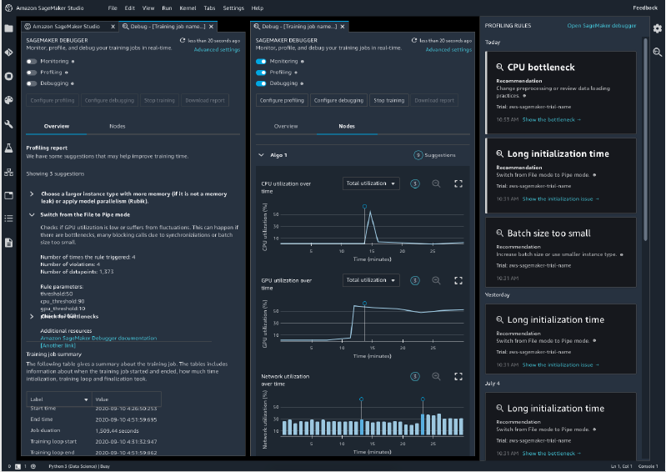
Monitor and profile system resource utilization
Automatically monitor system resource utilization
Profile training jobs to collect ML framework metrics
Visualize system resource utilization for GPU, CPU, network, memory within SageMaker Studio
Notes:
Amazon SageMaker Debugger automatically monitors system resource utilization metrics and allows you to profile your training jobs to collect detailed ML framework metrics. It then correlates anomalies in resource utilization to specific operations, and helps you to identify bottlenecks quickly. You can choose to profile your training runs either at the start of the training job or at any point when training is in progress. You can visualize different system resources including GPU, CPU, network, and I/O memory within SageMaker Studio and download a detailed report for offline analysis.

Slide 43
Analyze errors and take action
Built-in analysis in the form of rules
Automatically analyze training data including inputs, outputs, tensors
Detect if a model is overfitting or overtraining, or determine if gradient values are incorrect
Specify custom actions to stop training or send alerts
Notes:
Amazon SageMaker Debugger comes with built-in analysis in the form of rules that automatically analyze data emitted during training such as inputs, outputs, and transformations known as tensors. You can use the built-in rules for different scenarios, including to detect whether a model is overfitting or overtraining, whether gradients are getting too large or too small, or whether GPU resources are underutilized. With SageMaker Debugger, you can also create your own custom rules to analyze specific conditions in your training jobs. Further you can specify actions such as stop the training and send a SMS or an email when a rule is triggered.

Slide 44
Broad support across algorithms and frameworks
1. Supports popular ML algorithms such as XGBoost and deep learning frameworks such as TensorFlow, PyTorch, Apache MXNet, and Keras, with SageMaker built-in containers
2. Integrated with AWS Lambda to act on results from alerts
3. Invoke actions to automatically stop a training job when you detect a non-converging action such as losses increasing continuously
Notes:
Amazon SageMaker Debugger supports ML algorithms such as XGBoost and leading deep learning frameworks including TensorFlow, PyTorch, Apache MXNet, and Keras. The built-in containers within Amazon SageMaker for these frameworks come pre-installed with Debugger, enabling you to monitor, profile, and debug your training scripts easily. By default, SageMaker Debugger will monitor system hardware utilization and losses during training without additional code. Amazon SageMaker Debugger is integrated with AWS Lambda to act on results from alerts. As an example, you can invoke a Lambda function to automatically stop a training job when you detect a non-converging action, such as losses continuously increasing rather than decreasing over time.

Slide 45
Reduced training time
Reduce training time by 25% with synchronization across GPUs
Optimized for AWS
Achieve near-linear scaling efficiency with data parallelism designed for AWS
Distributed training The fastest and easiest way to train large deep learning models
Support for popular ML framework APIs
Re-use existing APIs such as Horovod without custom training code
Automatic and efficient model partitioning Avoid experimentation with automated model profiling and partitioning
Minimal code change Implement model parallelism with fewer than 10 lines of code change
Efficient pipelining Maximize resource usage with pipelining of micro-batches that keeps all GPUs active

Slide 46
How it works: Data parallelism library
Amazon S3
Store your training dataset
Amazon SageMaker
Includes a managed, optimized data-parallel training toolkit
Amazon SageMaker
Launch a SageMaker training job with data parallelism enabled
Fully managed training on replicas on workers
Supports popular APIs like Horovod and Distributed Data Parallel
Automatically synchronizes workers across multiple GPUs
Trained model in Amazon S3, ready to deploy
Import data parallelism library to training script
Notes:
Distributed Training
Amazon SageMaker makes it faster to perform distributed training by automatically splitting deep learning models and training datasets across AWS GPU instances with fewer than 10 lines of code.

Slide 47
How it works: Model parallelism library
Amazon S3
Store your training dataset
Amazon SageMaker
Includes a managed, optimized data-parallel training toolkit
Amazon SageMaker
Launch a SageMaker training job with data parallelism enabled
Fully managed training on replicas on workers
Supports popular APIs like Horovod and Distributed Data Parallel
Automatically synchronizes workers across multiple GPUs
Trained model in Amazon S3, ready to deploy
Import data parallelism library to training script
Notes:
Distributed Training
Amazon SageMaker makes it faster to perform distributed training by automatically splitting deep learning models and training datasets across AWS GPU instances with fewer than 10 lines of code.

Slide 48
Training time slows down development
Model: RoBERTa
Dataset: 300+ GB
Cluster: 64 p3dn.24xl
Training time: Several days
Credit: https://xkcd.com/303/
Notes:
Customers have told long training slow down their development.
When data scientists have to wait several days or even weeks for their models to complete training, it prevents them from iterating and getting their trained model into production.

Slide 49
Scaling to more GPUs can reduce training time
Scale to 8 nodes
Scaling Efficiency of P%
1 Node
Time-to-train: = T hours
Cost = T * instance price
8 Nodes
Time-to-train in hours = (T / nodes ) / P%
Cost = (T/ nodes) / P% * instance price
Example: With 90% scaling efficiency from 1 to 8 nodes, training time decreases by 86% and cost increases by 11%
Lower scaling efficiency introduce a trade-off
49
Notes:
And we know scaling to more GPUs can reduce training time
But how do we think about the benefits and costs of training a model on multiple GPU instances?
In an ideal case, if it takes you 8 hours to train with 1 node, it should take you 1 hour to train with 8 nodes. So your cost remains the same, but your time-to-train drops.
But in practice, you don't scale perfectly. And we'll talk in a few minutes about why that's the case.
We measure weak scaling efficiency as a percentage of the ideal, linear scaling efficiency, which is 100%.
So if you scaling efficiency is 90%, your training time decreases by 86% and your cost increases by 11%.
When scaling efficiency is high, you don't have a real trade-off between cost and time. When it's low, you have a trade-off.

Slide 50
Data parallelism in a nutshell
GPU 1
GPU 2
Record 1
Record 2
L1
L2
L3
L4
L1
L2
L3
L4
CPU
GPU 3
GPU 4
L1
L2
L3
L4
Record 3
Record 4
L1
L2
L3
L4
Dataset
Record 1
Batch 2b
Record 2
Record 3
Record 4
Record 5
…
50
Notes:
So let's do a quick recap of how data parallelism works
The core idea is that you parallelize training by giving each GPU a replica of the model and a subset of the training data.
Here we have four GPUs, each with a copy of the 4 layer neural network model, and each GPU gets different minibatches of my training data.
But if each GPU is training my model on a different slice of the training data, how do we reconcile and get a single model?
We need a way to synchronize gradients across machines.

Slide 51
Distributed deep learning, historically
Parameter server
E.g., TensorFlow
ParameterServerStrategy
Combiners worker & parameter servers to communicate and average gradients
AllReduce
E.g., Horovod, PyTorch DistributedDataParallel
Uses MPI to allow GPU nodes to communicate directly with each other in a “ring” topology
51
Notes:
There are two core approaches here
Parameter servers were the dominant way of synchronizing gradients.
Worker nodes pull the model from parameter servers, train with their minibatch, push their version of the model back up. Then the parameter server averages gradients and makes an updated model available to workers.
But this resulted in an imbalance in the amount of data being sent and received from each server, which caused bottlenecks and made the system less stable when you increased the size of the cluster.
The other and more dominant paradigm today is allReduce. Borrowing from the HPC community, we used MPI methods to accumulate gradients by letting GPU instances communicate directly, typically in a ring topology.
This addressed the latency and stability challenge of parameter servers but it still didn't efficiently utilize bandwidth on AWS.
And we challenged our teams to come up with a better way to do gradient synchronization at scale on AWS.
And we came up with a solution that takes the best of both worlds.

Slide 52
Historical AllReduce Clogs Network Bandwidth
Small cluster
Forward
Backward
AllReduce
Optimize
Larger cluster
Forward
Backward
AllReduce
Optimize
Even larger cluster
Forward
Backward
AllReduce
Optimize
52
Notes:
So let's go back to why scaling efficiency is often low. It's because the network becomes a bottleneck.
Typical neural network models have four components to their training loop, forward pass, backward pass, allReduce, and optimize steps.
As you add more machines to your cluster, the allReduce step takes longer and longer until it becomes your bottleneck.

Slide 53
Poor scaling efficiency with prior solutions
Even with more GPUs, you’re not getting anything from the extra compute
Your GPUs are underutilized
Number of GPUs | BERT-large on p3dn.24xlarge clusters
53
Notes:
And this hurts your scaling efficiency. You're adding more GPU instances to your cluster, but you're not benefitting from the additional compute and your GPUs are underutilized.

Slide 54
The best of both parameter servers and ring-based distribution
Our solution
With the same API’s

Slide 55
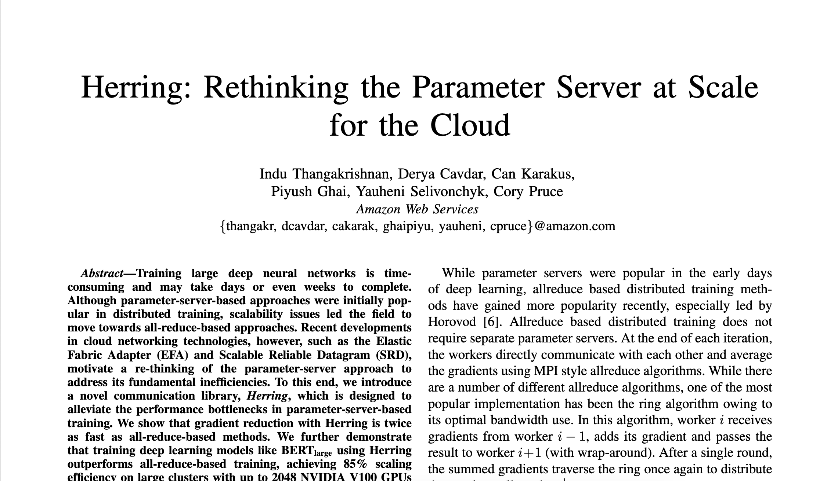
Record training times on AWS with NVIDIA GPUs
Presented at SC 20
https://www.amazon.science/publications/ herring-rethinking-the-parameter-server-at-scale-for-the-cloud
2018 | Fastest Resnet
2019 | Fastest BERT and Mask-RCNN
2020 | Fastest T5-3B and Mask-RCNN
55
Notes:
And teams within Amazon had been solving these problems internally for some time.
For three years in a row since 2018, we demonstrated the fastest training times on record for popular models like T5, BERT, Mask-RCNN and ResNet.
Last year we published some of the science behind these results at SC20

Slide 56
SageMaker DataParallel under the hood
SageMaker
control plane
Workers
on GPUs
Servers
on CPUs
With SageMaker DDP, the CPUs on your GPUs operate like parameter servers
We introduce Balanced Fusion Buffers to optimize your network bandwidth, holding gradients until they hit a threshold size, then copy to CPU memory, shard into N parts for each node in cluster, send ith part to the ith server
Now we can overlap backward pass and AllReduce
ml.p3dn.24xl
ml.p3dn.24xl
ml.p3dn.24xl
ml.p3dn.24xl
ml.p3dn.24xl
ml.p3dn.24xl
ml.p3dn.24xl
ml.p3dn.24xl
56
Notes:
So how does it work under the hood?
When you launch a training job with SageMaker Data Parallel, the CPUs on your GPU instances become parameter servers.
We introduce a new technique called Balanced Fusion Buffer to make optimal use of bandwidth. A buffer in the GPU holds gradients until they hit a threshold size.
We then copy the fused buffer to CPU memory, shared into N parts for each node in our cluster and then send the ith part to the ith server.
This balances the data being sent and received from each parameter server, ensuring bandwidth is efficiently utilized and addressing the primary challenge with traditional parameter servers.
Because we designed this allReduce algorithm for AWS infrastructure and topology, it is more stable and fault tolerant.
Another benefit of offloading allReduce from GPUs to CPUs is that we can now overlap backward pass and allreduce, reducing overall step time and freeing up GPU resources.

Slide 57
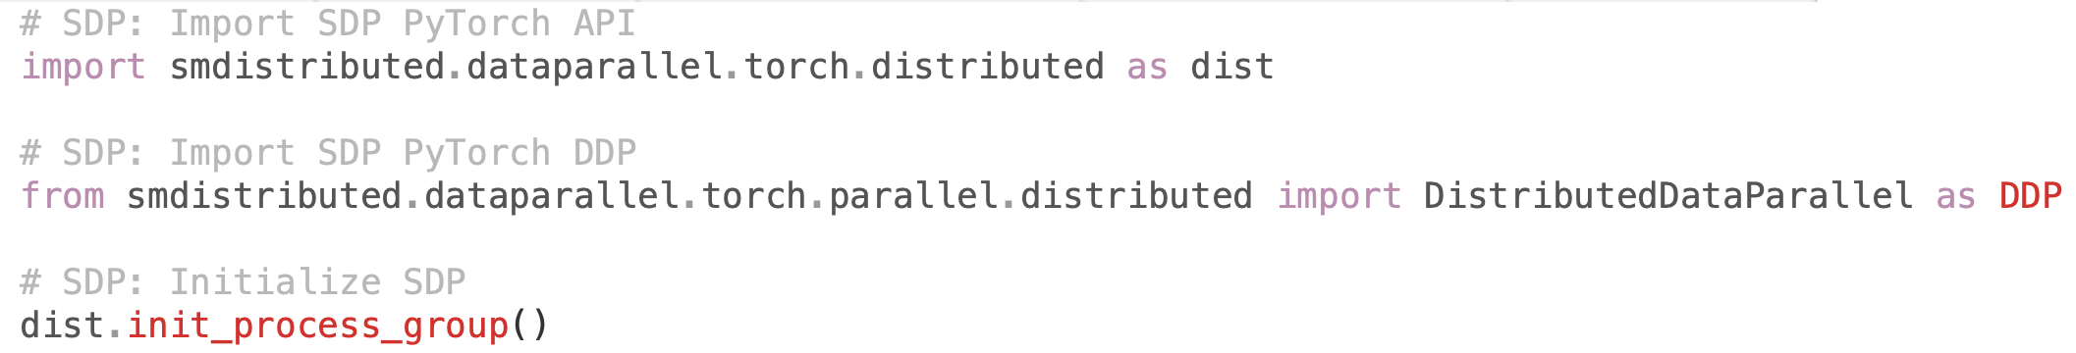
Using data parallelism with PyTorch
Import and initialize sagemaker dataparallel library
57
Notes:
We start by importing the smdistributed library and initializing it
If you've used PyTorch DDP, this should look identical and intuitive to you

Slide 58
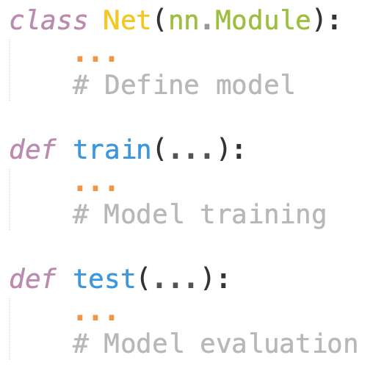
Using data parallelism with PyTorch
No change to core training loop
No changes to model definition, core training loop, evaluation.
58
Notes:
No changes are required to your model definition, core training loop, evaluation.

Slide 59
Model parallel – think “massive models”
Notes:
Now let's look at challenges with model parallelism

Slide 60
Deep learning models are growing in size
MODEL | RELEASED | # PARAMETERS
BERT | Oct 2018 | 340 M
GPT-2 | Feb 2019 | 1.5 B
T5 | Oct 2019 | 11 B
GPT-3 | Jul 2020 | 175 B
60
Notes:
Deep learning models are growing in size.
In just 2 years our customers have gone from using models with hundreds of millions of parameters to hundreds of billions. And the latest papers now talk of trillions.

Slide 61
Larger models have higher prediction accuracy
NATURAL LANGUAGE PROCESSING
GPT-2 size (# parameters)
LAMBADA perplexity
LAMBADA accuracy
117M
35.13
45.99
345M
15.60
55.48
762M
10.87
60.12
1.542B
8.63
63.24
COMPUTER VISION
Model | # Parameters | ImageNet accuracy
ResNet-152
ResNeXt-101
AmoebaNet-C
AmoebaNet-B
~60M
80%
~80M
81%
~120M
83%
~550M
84.4%
61
Notes:
And the reason for this trend is that larger models are improving accuracy
They're also allowing us to do zero/one/few shot learning during inference, which saves us from the time and cost of preparing a large labeled dataset and fine-tuning it. One large model can be reused several times in different domains with little or no fine-tuning

Slide 62
But hardware improvements are not keeping up
Hardware capacity grows too - but not as fast
INSTANCE TYPE | AVAILABLE | GPU | GPU MEMORY
P2.16xlarge | Sep 2016 | NVIDIA K80 | 12 GB
P3.16xlarge | Oct 2017 | NVIDIA V100 | 16 GB
P3dn.24xlarge | Dec 2018 | NVIDIA V100 | 32 GB
P4d.24xlarge | Nov 2020 | NVIDIA A100 | 40 GB
The speed of model size growth is outpacing hardware improvements, leading to memory bottlenecks.
62
Notes:
We see hardware improve as well but model sizes are growing faster

Slide 63
Memory bottlenecks in training large models
Model sizes can be limited by memory of a single GPU
Large models cause OOM errors
Naive approaches to model parallel replicate the entire model across all GPUS
Wasteful when model is large, gets you even more OOM errors
Hardware limitations without optimal usage can limit both research and applications
GPU
GPU
GPU
GPU
L1
L2
L3
L4
L1
L2
L3
L4
L1
L2
L3
L4
L1
L2
L3
L4
Data 1
Data 2
Data 3
Data 4
Amazon S3
63
Notes:
The result is that memory becomes a bottleneck in training
Model size is limited by the memory of a single GPU, producing out of memory errors
Replicating the entire model across GPUs is also wasteful when the model is large

Slide 64
Model parallelism on Amazon SageMaker (SMP)
Automated model partitioning
Interleaved pipelined training
Managed SageMaker training
Clean framework integration
64
Notes:
Now let's look at the modelparallel library
It automatically and efficiently partitions your model. It setups up an efficient pipeline that maximizes GPU utilization.
All of this takes place in a fully managed environment in SageMaker and is integrated with TensorFlow and PyTorch

Slide 65
1. Use SMP to automate your model partitioning
Analyzed Model
graph structure
sizes of trainable weights
sizes of exchanged tensors (using sagemaker debugger)
Run Graph Partitioning Algorithm
balance stored weights and activations
minimize communication
Place Partitions On Devices
to be executed in a pipelined manner
65
Notes:
So let's see how this works
When you create a training job, SageMaker analyzes the model graph, including analyzing tensors using SageMaker Debugger.
SageMaker then partitions the graph in a way that balances compute and minimizes communication.
Finally, it sets up an efficient pipeline to execute minibatches

Slide 66
2. Interleave pipeline execution to stabilize GPU utilization
GPU
GPU
GPU
GPU
Split minibatches into N “microbatches”
Feed microbatches sequentially, but process them to keep GPU utilization more even
Minimize “idle” time on GPUs
Data 1
Data 1
Data 1
Data 1
Data 2
Data 2
Data 2
Data 2
Data 3
Data 3
Data 3
Data 3
Data 4
Data 4
Data 4
Data 4
Data 1
Model
Data 2
Data 3
Data 4
Amazon S3
66
Notes:
SageMaker splits each batch into N microbatches, which are fed sequentially.
This minimizes the amount of time GPUs are idle and waiting for data.

Slide 67
Using model parallel in SageMaker with PyTorch - Demo
Notes:
Now let's walkthrough an example with modelparallel training

Slide 68
Session IV
SageMaker Hosting Deep Dive

Slide 69
Wide selection of infrastructure
70+ instance types with varying levels of compute and memory to meet the needs of every use case
Single-digit millisecond overhead latency
For use cases requiring real-time responses
Asynchronous inference
Supports large models with long-running processing times
Deploy ML models
Fully managed deployment for inference at scale
Cost-effective deployment
Multi-model/multi-container endpoints, serverless inference, and elastic scaling
Built-in integration for MLOps
ML workflows, CI/CD, lineage tracking, and catalog
Automatic deployment recommendations
Optimal instance type/count and container parameters, and fully managed load testing
Notes:
1/ Amazon SageMaker make it easy to deploy and manage machine learning models at scale. As a fully managed service, SageMaker takes care of setting up and managing instances for inference, ensuring software version compatibilities, and patching versions. SageMaker also provides built-in metrics and logs for endpoints that you can use to monitor and receive alerts.
2/Amazon SageMaker offers more than 70 instance types with varying levels of compute and memory, including Amazon EC2 Inf1 instances based on AWS Inferentia, high-performance ML inference chips designed and built by AWS, and GPU instances such as Amazon EC2 G4dn to meet the performance and cost requirements of any use case, including real-time, high throughput, and batch inference.
3/SageMaker allows developers to access deployed models through API requests with response times as low a few milliseconds. This supports use cases requiring real-time responses, such as ad serving, fraud detection, and personalized product recommendations.
4/For inference requests that take longer to finish, SageMaker offers asynchronous inference, which supports processing times up to 15 minutes and payloads up to 1 gigabyte. Asynchronous inference is best suited for use cases requiring real-time user experience, but use large CV or NLP models. With asynchronous inference, your inference requests get separated from your backend application and web servers to prevent long-running inference requests from blocking your calling application. Asynchronous inference can also scale your model serving instance count down to zero, optimizing your costs when you don't need to make inference requests.
5/SageMaker provides scalable and cost-effective ways to deploy ML models, whether it’s one model or a large number of models. SageMaker multi-model endpoints and multi-container endpoints enable you to deploy thousands of models on a single endpoint, improving cost-effectiveness while providing the flexibility to utilize models as often as you need them. For use cases with intermittent inference requests (long idle periods between inference requests), SageMaker Serverless Inference automatically provisions, scales, and turns off compute capacity based on the number of inference requests. SageMaker Serverless Inference, the service automatically removes the need to manage complex scaling workflows by ensuring the exact amount of resources are available for inference to save time and money. For all other use cases, you can use autoscaling in SageMaker policies to elastically scale the underlying compute resources to accommodate fluctuations in inference requests, while reducing cost.
6/SageMaker model deployment features are natively integrated with MLOps capabilities, including SageMaker Pipelines (workflow automation and orchestration) and SageMaker Projects (CI/CD for ML), SageMaker Feature Store (feature management), SageMaker Model Registry (model and artifact catalog to track lineage and support automated approval workflows), SageMaker Clarify (bias detection), and SageMaker Model Monitor (model and concept drift detection). As a result, deploying one model or tens of thousands of models, SageMaker helps offload the operational overhead of deploying, scaling, and managing ML models while also getting your models to production faster. SageMaker also allows you to implement advanced deployment capabilities for ML, such as A/B testing, canary, batch, and blue/green deployments. Using these techniques, data scientists can rapidly release model updates, avoid downtime during deployment, and benchmark the performance of their models in development, test, and production environments.
7/SageMaker Inference Recommender helps you automatically select the optimal compute instance and configuration (e.g. instance count, container parameters, and model optimizations) to deploy your machine learning models. SageMaker Inference Recommender reduces the time to deploy from weeks to hours by automatically recommending the ideal compute instance configuration and model optimizations. You can use SageMaker Inference Recommender to deploy the model to one of the recommended compute instances, or use the service to run a load test across a range of compute instance types you select. Load testing is fully managed so you don’t need to manage any testing infrastructure. You can review the benchmark results in SageMaker Studio and evaluate the tradeoffs between different configuration settings including latency, throughput, cost, CPU/GPU usage, and memory. SageMaker Inference Recommender allows you to optimize price performance of your inference workload.
Transition: Machine learning lifecycle doesn't stop there. Once models are deployed they need to be monitored for quality and performance and retrained when new data is available or the business and user dynamics change. So model development and deployment is not a one-and-done task. Handling the iterative nature of ML lifecycle requires ML operations (or MLOps) practices. That brings us to the next component of SageMaker.

Slide 70
SageMaker inference options
Real-time inference
Batch transform
(NEW)
Asynchronous inference
Low latency
Ultra high throughput
Multi-model endpoints
A/B testing
Process large datasets
Job-based system
Near real-time
Large payloads (1 GB)
Long timeouts (15 mins)

Slide 71
Serverless Inference Fully managed offering
Managed infrastructure
Serverless
Automatically scale out, in, and down to 0
Security
Monitoring
Logging
Built in availability and fault tolerance
No need to select instance types or provision capacity
Choose memory options based on inference processing needs
No need to set scaling policies

Slide 72


Amazon SageMaker Deployment
SageMaker Endpoints (Private API)
Deployment / Hosting
Amazon SageMaker ML
Compute Instances
Auto Scaling group
Availability Zone 1
Prediction
(Response)
Availability Zone 2
Input Data
(Request)
Elastic
Load Balancing
Model
Endpoint
Client
Availability Zone 3
72
Notes:
Client is with in AWS environment

Slide 73

Amazon SageMaker Deployment
SageMaker Endpoints (Public API)
Deployment / Hosting
Amazon SageMaker ML
Compute Instances
Auto Scaling group
Availability Zone 1
Prediction
(Response)
Availability Zone 2
Input Data
(Request)
Amazon
API Gateway
Elastic
Load Balancing
Model
Endpoint
Client
Availability Zone 3
73
Notes:
Accessing the endpoint from a client external to AWS

Slide 74
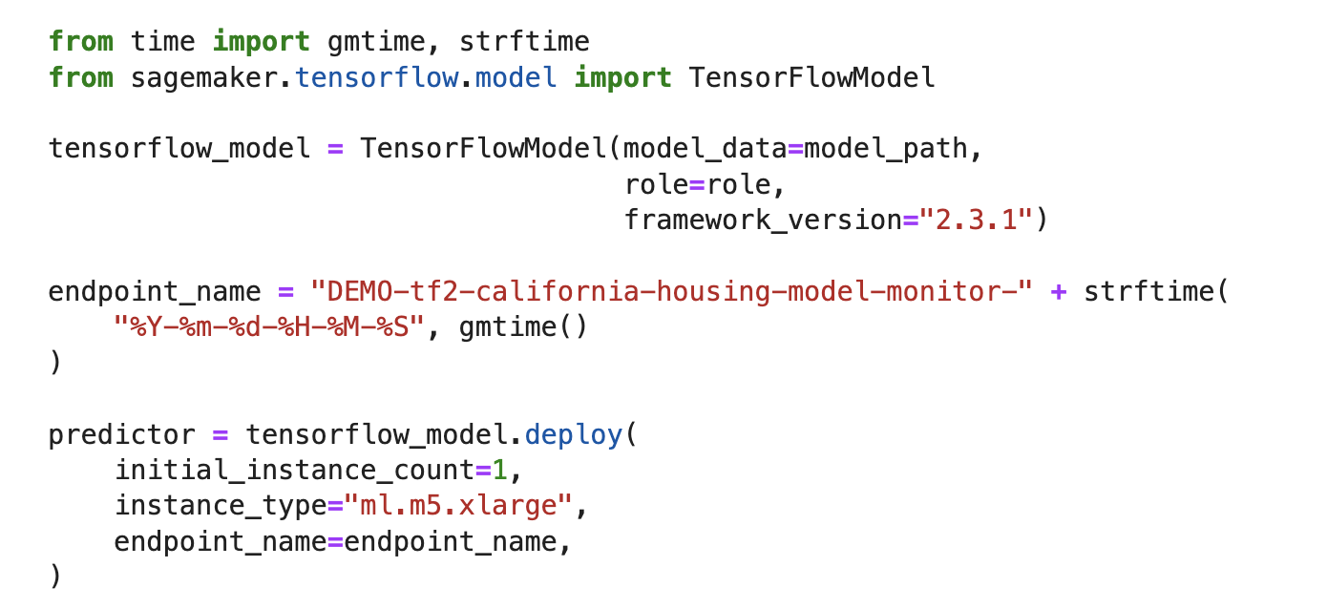
Real time Inference
Notes:
Realtime inference

Slide 75
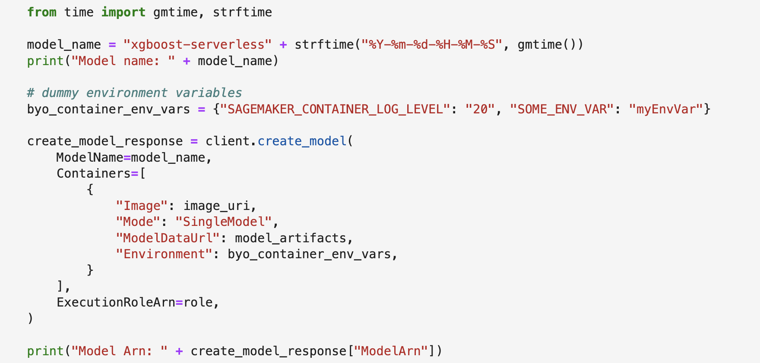
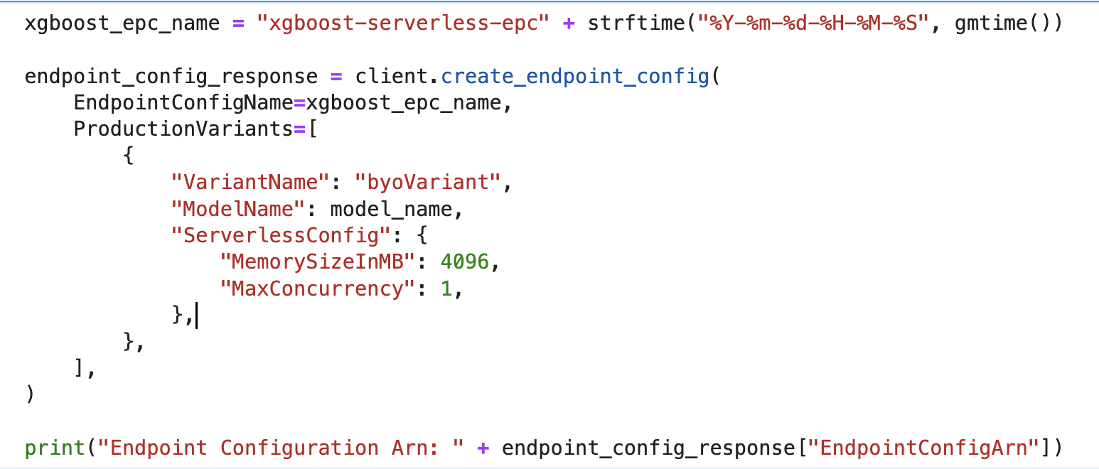
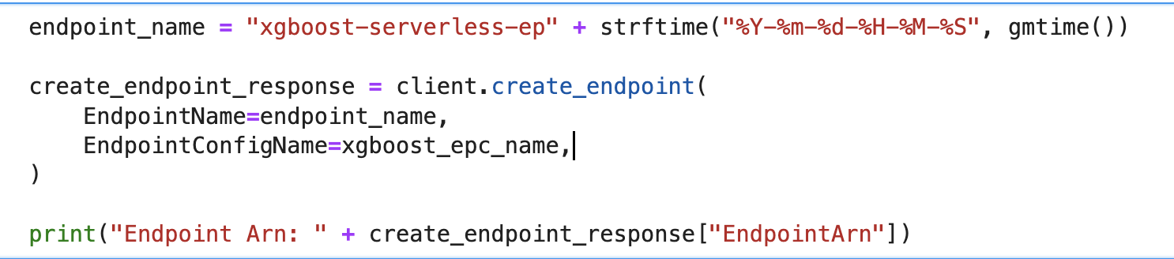
Serverless Inference
Step1 : Create Model
Step2 : Create Endpoint Configuration
Step3 : Create Endpoint

Slide 76
Amazon SageMaker Deployment
Batch Hosting
Batch Cluster
on ML Compute Instances
Batch Transform
Predictions for an entire dataset
Transient resources (instances provisioned and terminated once job is done)
No infrastructure to manage
Can associate prediction results with input
Supports Built-In/Bring-Your-Own
Request Data
Transformed Data
Batch Agent
Data
Results
Helper
Code
Inference
Code
Model
Artifacts
Inference code Images
76
Notes:
Inference traffic data in S3
Inference results also back in S3
To get inferences for an entire dataset, use batch transform. With batch transform, you create a batch transform job using a trained model and the dataset, which must be stored in Amazon S3. Amazon SageMaker saves the inferences in an S3 bucket that you specify when you create the batch transform job. Batch transform manages all of the compute resources required to get inferences. This includes launching instances and deleting them after the batch transform job has completed. Batch transform manages interactions between the data and the model with an object within the instance node called an agent.
Use batch transform when you:
Want to get inferences for an entire dataset and index them to serve inferences in real time
Don't need a persistent endpoint that applications (for example, web or mobile apps) can call to get inferences
Don't need the subsecond latency that Amazon SageMaker hosted endpoints provide
You can also use batch transform to preprocess your data before using it to train a new model or generate inferences.

Slide 77
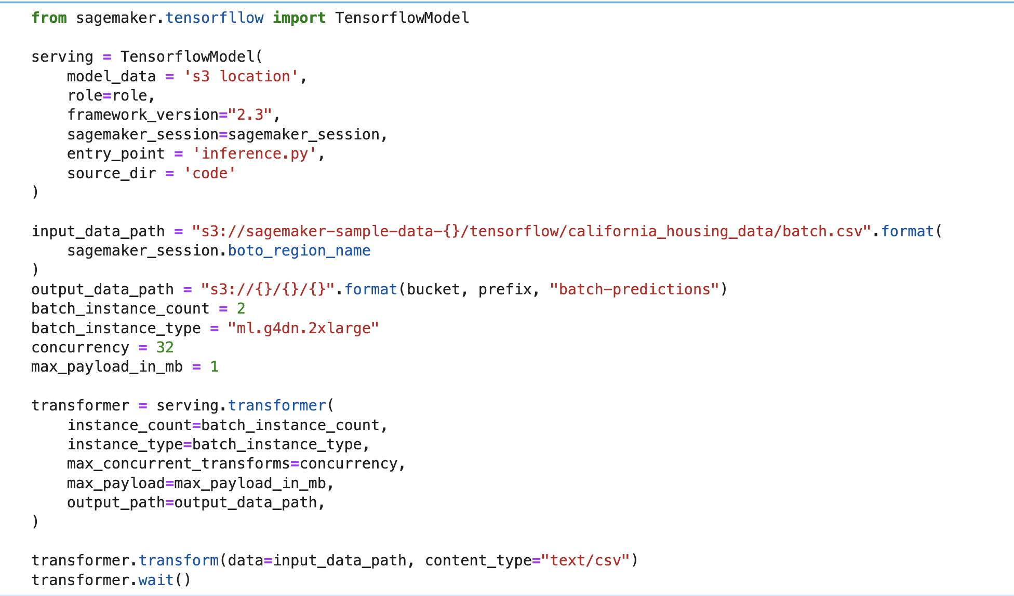
Batch Inference

Slide 78
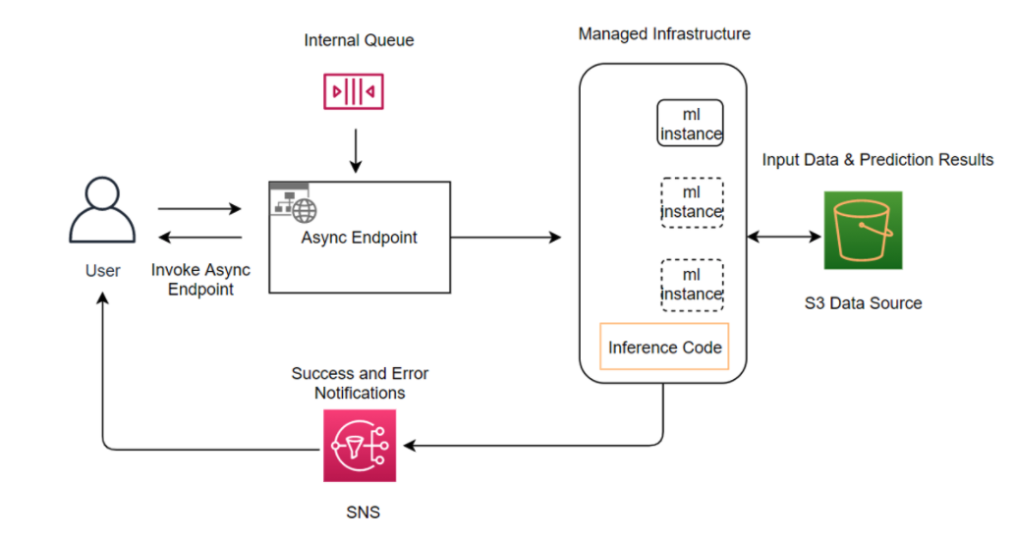
Async Inference

Slide 79

Inference Pipelines for sequential execution of models
Execute data processing on inference requests, maintain single copy of data processing code for training and inference
Raw Payload (csv)
SparkML Serving Image
Preprocessing Docker Container
Built-in containers — Scikit-Learn and Apache Spark MLLib
Add up to 5 containers; execute sequentially
Containers co-located on instance for low latency
Preprocessor Artifacts
XGBoost Image
XGBoost Model Docker Container
XGBoost Artifacts
Post-processing Docker Container
SparkML Serving Image
Post-processor Artifacts
Deployment/hosting
Amazon SageMaker
Deploy Inference Pipeline on Endpoint with Preprocessing and Post-processing
Post-processed output (csv)
79

Slide 80
Amazon SageMaker Deployment
Multi-Model Endpoints
Client Application
Invoke Endpoint: TargetModel = Model-1
Scalable/Cost Effective for large number of models
Works best when models are of similar size and latency
Automatic memory handling
Inference request
Inference result
Secure Endpoint
Model
Artifacts
Model-1
Model
Artifacts
Model-2
Helper
Code
Inference
Code
Helper
Code
Inference
Code
Pre
fix = SalesForecast/
Prefix = SalesForecast/
Container
Container
80
Notes:
Model is loaded into containers memory on first invoke. If model is already loaded, traffic continues to be sent to the instance with the model already loaded unless there are many invocations in which case is will begin to distribute.
Models must have same S3 prefix

Slide 81
SageMaker Model Monitoring

Slide 82
Model Monitor: how it works
Deploy trained model
Enable data capture on SageMaker Endpoint
Schedule monitoring jobs
Detect and monitor data quality, model accuracy, bias, and explainability drift
CloudWatch alerts
Retrain models/ update data
Generate baseline
Statistics and constraints
View drift monitoring results
Reports in S3, visualize metrics in Studio, analyze in Notebooks
Collect ground truth
Merge with predictions
Notes:
Using these sagemaker model monitor capabilities, an end to end flow for deploying and monitoring the models in production looks like this - Starting with deploying trained model and ending with taking action once data / model drift is detected

Slide 83
Session V
SageMaker MLOps capabilities
Notes:
Let’s look at built-in MLOps capabilities in Amazon SageMaker.

Slide 84
Operational challenges with managing the ML lifecycle
Manual iterative processes slow down ML innovation
Difficult to scale the number of models in production
CI/CD for ML requires writing custom code
Compliance requirements are difficult to meet
84
Notes:
1/ML lifecycle is an iterative, manual process where data scientists first prepare their data using different data transformations, and then build, train, and deploy models. These manual steps can slow down data scientists since building even a single model requires experimentation with thousands of iterations to arrive at the right model parameters. Even after a model is deployed in production, the accuracy of ML models can deteriorate over time, a phenomenon known as model drift. Many factors can cause model drift, such as changes in model features. The accuracy of ML models can also be affected by concept drift, the difference between data used to train models and data used during inference. When these occur, the model needs to be retrained. Thus model building is not a one-and-done task and the manual steps can delay innovation and waste data scientists time.
2/With the growing number of models, these manual processes get amplified and hinder ML adoption across the organization. In addition, as the number of models and model versions grow, it becomes difficult for data scientists to trace back to training data used and model artifacts when issues come up in model predictions. Lastly, data scientists cannot collaborate with each other without repeatable experiments and lineage tracking.
3/And, similar to deploying software updates, deploying ML model updates require CI/CD practices to avoid downtime during deployment and to benchmark the performance of models in production environments. But software CI/CD tools cannot handle ML model updates since ML involved both data and code. As a result, MLOps engineers have to write custom code to build CI/CD for ML.
4/Regulations such as the Equal Credit Opportunity Act or the Fairness in Housing Act may require companies to be able to explain financial decisions and take steps around model risk management. Meeting these requirements require building custom security and governance solutions, which can take months or even years.
Transition: Amazon SageMaker provides comprehensive MLOps capabilities to overcome these challenges.

Slide 85
Automate ML workflows to scale model development
Build CI/CD pipelines for ML to accelerate model deployment
Amazon SageMaker MLOps Streamline the ML lifecycle
Catalog model versions, metadata, metrics, and approvals for traceability and reusability
Track lineage for troubleshooting and compliance
Maintain accuracy of predictions after models are deployed
Enhance governance and security
85
Notes:
1/Amazon SageMaker helps you automate and standardize MLOps practices across your organization.
2/Amazon SageMaker Pipelines is a fully managed feature that helps you automate and orchestrate different steps of the ML workflow, including data loading, data transformation, bias detection, model building, training, and evaluation. Process massive amounts of training data and build and retrain models at any scale. Share and reuse workflows to recreate or optimize models to scale ML across your organization.
3/Amazon SageMaker Projects brings CI/CD practices to ML, such as maintaining parity between development and production environments, source and version control, automated testing, and end-to-end automation. These help you standardize ML deployment processes and accelerate model deployment from days to minutes.
4/Many customers train hundreds of models for a given use case, each with multiple versions. Tracking these models and their versions and the associated metadata is critical for repeatability and discoverability to enable model reuse and meet compliance requirements. With the SageMaker Model Registry, you can track model versions, their metadata such as use case grouping, and model performance metrics baselines in a central repository where it is easy to choose the right model for deployment based on your business requirements. Model Registry automatically logs the approval workflows for audit and compliance.
5/Amazon SageMaker logs every step of your workflow, creating an audit trail of model artifacts, such as training data, platform configurations, model parameters, and learning gradients. Use audit trails to recreate models to debug potential issues and help support compliance requirements.
6/Amazon SageMaker Model Monitor, which detects model drift and concept drift in models deployed in production in real time, is now integrated with SageMaker Pipelines and SageMaker Model Registry, allowing you to automatically schedule model monitoring as part of CI/CD. This allows you to automate the task of maintaining the quality of model predictions in production.
7/Amazon SageMaker offers a comprehensive set of security features—including infrastructure security, data protection, authorization, authentication, monitoring, and auditability—to help your organization with security requirements that may apply to ML workloads. Using SageMaker, you can standardize security policies across the entire ML development process to increase your security posture and reduce the time it takes to provide data scientists with access to the data they need, while complying with your organization’s data security requirements.
Transition: Now that we have gone through the significant challenges and how SageMaker helps overcome them, I’d like to spend a minute summarizing the value SageMaker brings to your business and present a few customer examples.

Slide 86
Amazon SageMaker MLOps
Components
1
Project
2
3
Pipelines
Model Registry
Model Deployment Pipeline
</>
Source Code Control
Built-In
Triggers
Automated Model Build Workflows
Central Store to manage models
End-to-End Traceability & Integration
86
Notes:
1/ Amazon SageMaker Pipelines is an ML CI/CD service accessible to every developer and data scientists. SageMaker Pipelines brings CI/CD pipelines to ML reducing the months of coding required to manually stitch together different code packages to just a few hours.
2/With just a few clicks in SageMaker Pipelines, you can create an automated machine learning workflow.
3/SageMaker Pipelines takes care of all the heavy lifting involved with managing the dependencies between each step of the workflow and orchestrates them so you can scale to thousands of models in production and expand your use of machine learning across more lines of business.
4/Pipelines provides comprehensive steps including data preparation, transformation in Data Wrangler, algorithm set up, debugging, model optimization and more. Pretty much anything you can do in SageMaker you can add to your workflow.
5/SageMaker Pipelines keeps track of every step and you can rerun the workflow at any time. Workflows can be shared and re-used between teams inside your organization, either to recreate a model, or as a starting point to make improvements through new features, new algorithms, or new optimizations.
6/To help you get started quickly, SageMaker Pipelines offers preconfigured templates for model building and model deployment pipelines and the templates are fully customizable.
7/And once created, the workflows can be visualized and managed in SageMaker Studio enabling you to compare model performance so you can then select and deploy the best model for your use case

Slide 87
Amazon SageMaker MLOps
Components
Flexible
Use Projects for end-to-end pipelines that incorporate CI/CD practices
Optionally, use Pipelines or Model Registry without Projects to meet the needs of your use case
1
Project
2
3
Pipelines
Model Registry
Model Deployment Pipeline
</>
Source Code Control
Built-In
Triggers
Automated Model Build Workflows
Central Store to manage models
End-to-End Traceability & Integration
87

Slide 88
Amazon SageMaker Pipelines
Components
1
Extensible
Take advantage of built-in MLOps Project Templates (or)
Create custom MLOps Project Templates to meet the unique demands of your corporate or regulatory requirements
Project
2
3
Pipelines
Model Registry
Model Deployment Pipeline
</>
Source Code Control
Built-In
Triggers
Automated Model Build Workflows
Central Store to manage models
End-to-End Traceability & Integration
88

Slide 89
SageMaker Pipelines

Slide 90
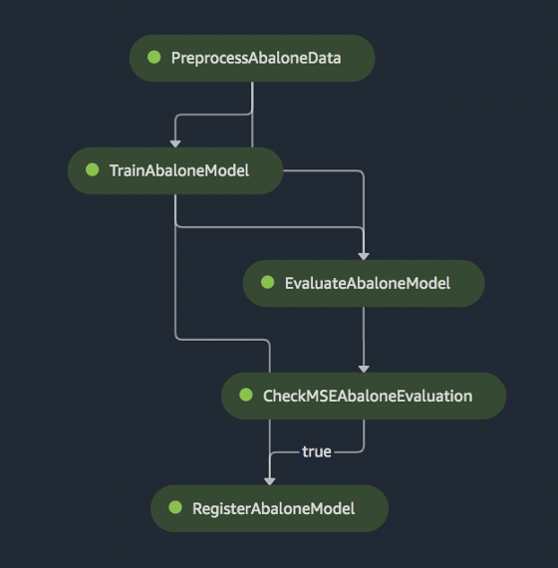
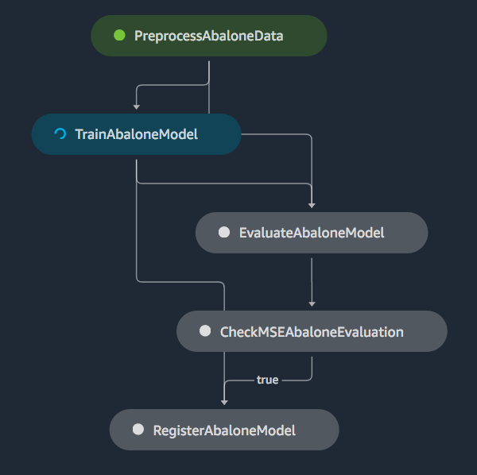
Creating Amazon SageMaker Automated Pipelines
Pipeline-as-Code
How it Works …
1. Create Steps Define & configure each step
2. Define Pipeline Define & configure the workflow
3. Start Pipeline Execute the pipeline
Step 1
Step 2
Step 3
Step 4
Step 5
90

Slide 91
Amazon SageMaker Pipelines
Support for Step Caching
Raw Data
Data Processing
SageMaker Processing Job
What if you want to:
tweak hyperparameters?
modify training code?
Training Data
Training
SageMaker Training Job
91
Notes:
When you use step signature caching, before SageMaker Pipelines executes a step, it attempts to find a previous execution of a step that was called with the same arguments. SageMaker Pipelines checks that the call signatures are identical. Pipelines doesn't check whether the data or code that the arguments point to has changed. If a previous execution is found, a cache hit is created. Pipelines then propagates the values from the cache hit during execution, rather than recomputing the step.
Step caching only considers successful executions, so no failed executions are ever reused. When multiple successful executions exist within the timeout period, Pipelines uses the result for the most recent successful execution. If no successful executions match in the timeout period, Pipelines won't reuse any steps. If the executor finds a cache hit for a previous step execution that is still in progress, both steps continue executing and update the cache, if they're successful.
You must opt-in to step caching, otherwise it is off by default. When you enable step caching, you must also define a timeout. This timeout defines how old a previous execution can be to be considered for reuse.
Step caching is only scoped for individual pipelines, so you can’t reuse a step from another pipeline. Even if there is a step signature match in the other pipeline, the step is not reused.
Step caching is available for the following step types:
Training
Processing
Transform

Slide 92
Amazon SageMaker Pipelines
Support for Pipeline Parameters
2. Pass in parameter on pipeline create
pipeline = Pipeline(
name=pipeline_name,
parameters=[
processing_instance_count
],
steps=[step_process]
)
1. Configure your parameter
from sagemaker.workflow.parameters import (
ParameterInteger,
ParameterString,
ParameterFloat
)
processing_instance_count = ParameterInteger(
name="ProcessingInstanceCount",
default_value=1
)
3. Optionally, pass a non-default value for pipeline execution
execution = pipeline.start(
parameters=dict(
ProcessingInstanceType="ml.c5.xlarge", ModelApprovalStatus="Approved”
)
)
92
Notes:
You can introduce variables into your pipeline definition using parameters. Parameters that you define can be referenced throughout your pipeline definition. Parameters have a default value, which you can override by specifying parameter values when starting a pipeline execution. The default value must be an instance matching the parameter type. All parameters used in step definitions must be defined in your pipeline definition. Amazon SageMaker Model Building Pipelines supports the following parameter types:
ParameterString – Representing a str Python type.
ParameterInteger – Representing an int Python type.
ParameterFloat – Representing a float Python type.
Examples:
- instance type(s)
Instance count(s)
Input data location
2. You pass the parameter when creating your pipeline as follows:
3. You can also pass a parameter value that differs from the default value to a pipeline execution as follows:

Slide 93
SageMaker Model Registry

Slide 94
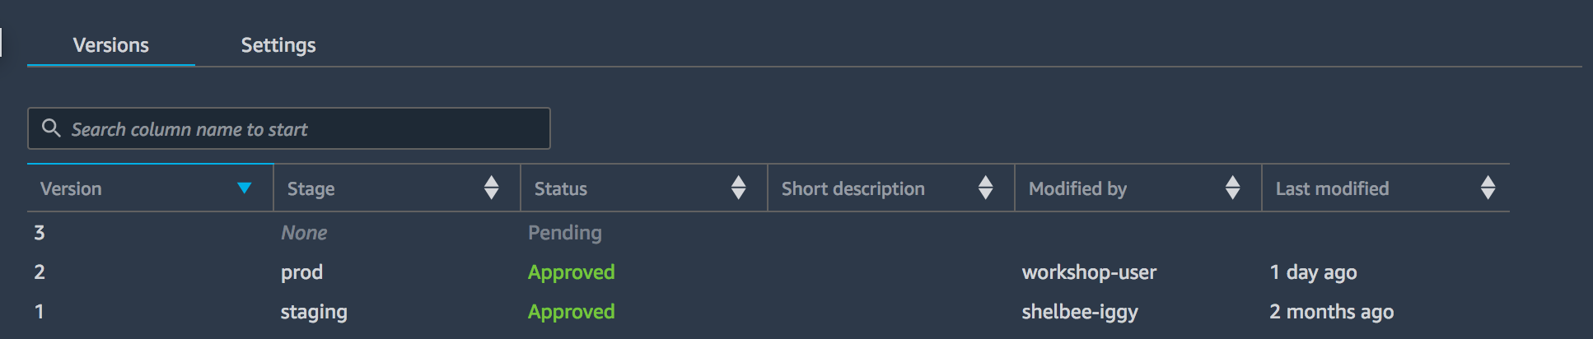
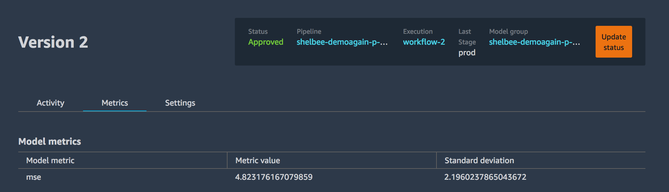
Amazon SageMaker Pipelines
Model Registry
Catalog models for production
Manage model versions
Associate metadata with a model
Manage the approval status of a model
Deploy models to production (with Projects)
Track model performance metrics
Rollback model versions
94
Notes:
AWS Native
Speak to the extra text

Slide 95
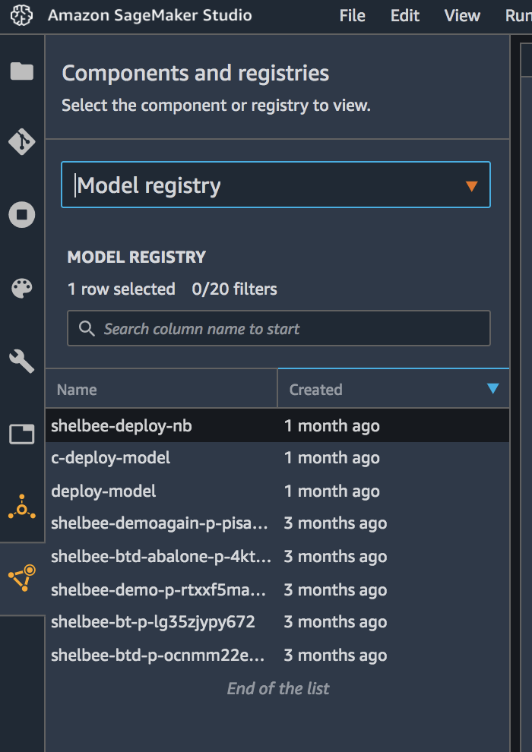

Amazon SageMaker Pipelines
Model Registry
Hierarchy
Model Registry
Model Group (1)
Model Group (2)
Model Group (n)
vn
vn
v1
v1
v2
v1
95
Notes:
AWS Native
Speak to the extra text

Slide 96
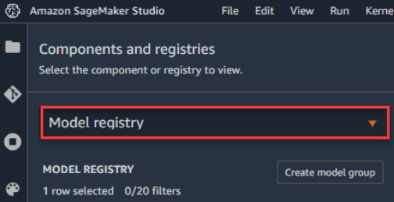
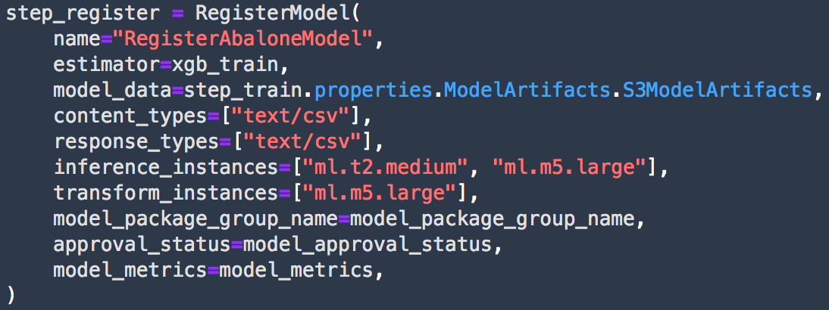
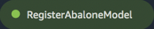
Amazon SageMaker Pipelines
Model Registry
How it Works …
1. Create Model Group
2. Register a Model Version Within a Pipeline, using RegisterModel Step:
create_model_package_response = sm_client.create_model_package(**create_model_package_input_dict)
model_package_arn = create_mode_package_response["ModelPackageArn"]
print('ModelPackage Version ARN : {}'.format(model_package_arn))
OR using boto3
96
Notes:
Create Model Group:
To create a model group by using Boto3, call the create_model_package_groupmethod, and specify a name and description as parameters. The following example shows how to create a model group. The response from the create_model_package_group call is the Amazon Resource Name (ARN) of the new model package group.
Register Model Version:
You register a model by creating a model version that specifies the model group to which it belongs. A model version must include both the model artifacts (the trained weights of a model), and the inference code for the model. Create a model version by using either the AWS SDK for Python (Boto3) or by creating a step in a SageMaker mode building pipeline. You register a model by creating a model version that specifies the model group to which it belongs. A model version must include both the model artifacts (the trained weights of a model), and the inference code for the model. Create a model version by using either the AWS SDK for Python (Boto3) or by creating a step in a SageMaker mode building pipeline.

Slide 97
SageMaker Projects

Slide 98
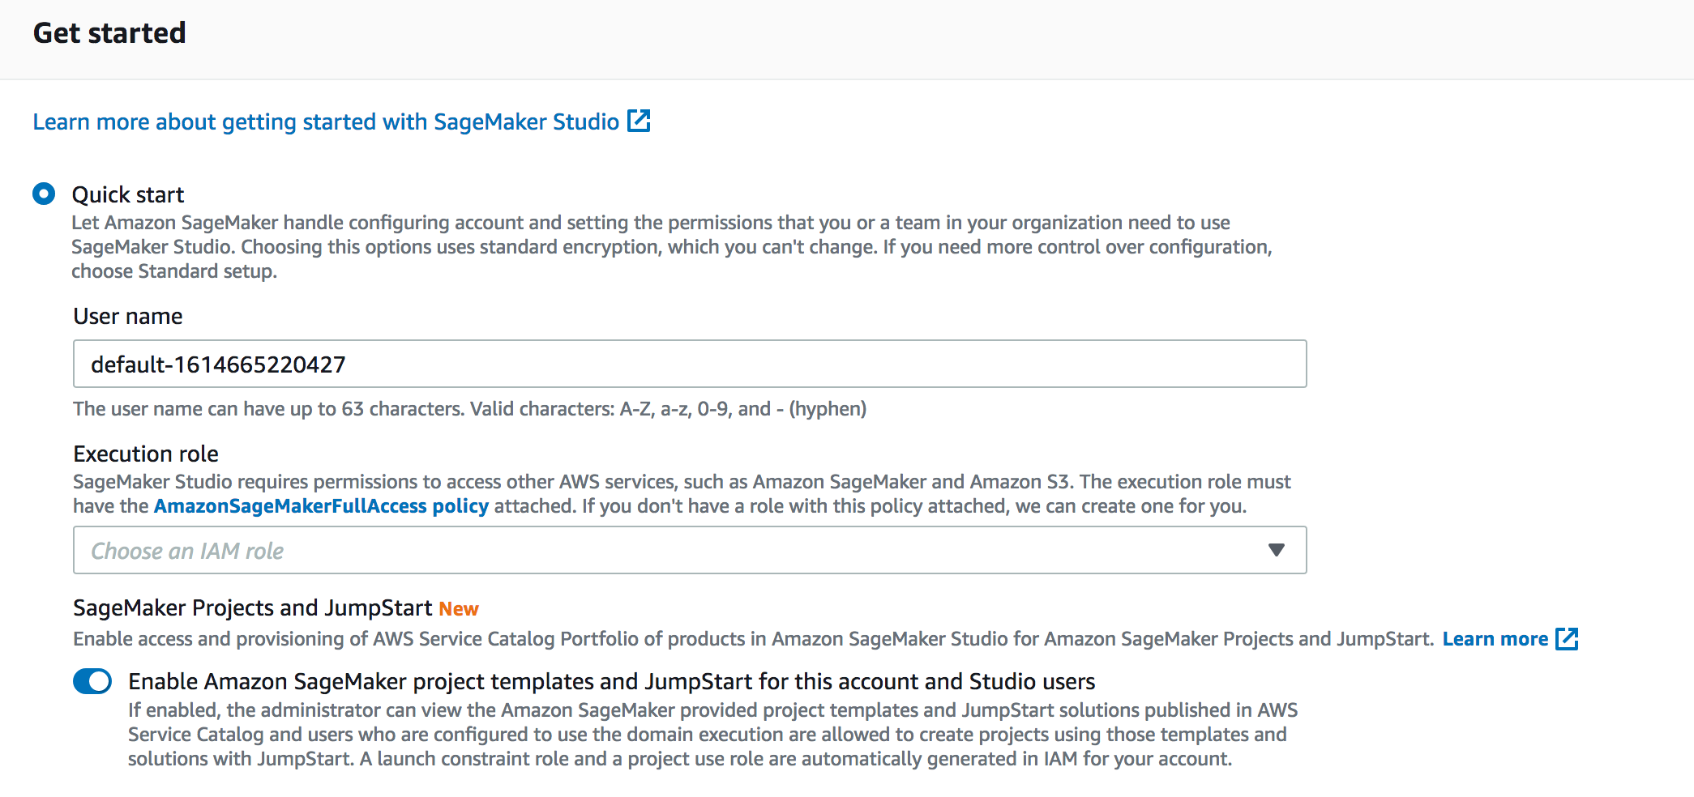
Amazon SageMaker Pipelines - Projects
Getting Started
One-Time Setup
1. Enable Projects for your Studio Domain
Enable on a new domain or update an existing domain
98
98

Slide 99
Amazon SageMaker - Projects
Features
Utilize Built-In MLOps Project Templates:
Build, Train, Deploy
Build, Train
Deploy
Create Custom MLOps Project Templates

Slide 100
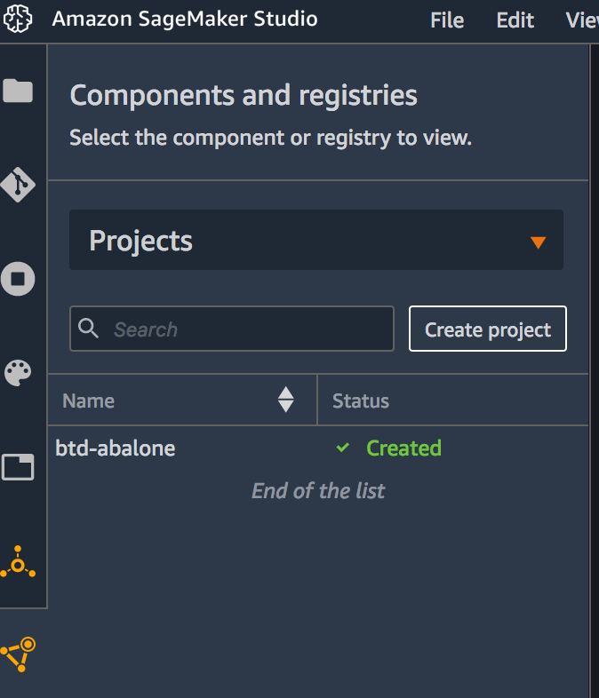
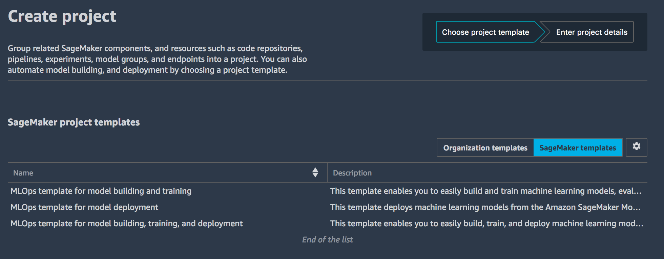
Amazon SageMaker Pipelines - Projects
Built-In ML-Ops Project Templates
How it Works …
1. Select Create Project
2. Select Template
Everything needed to create a CI/CD Pipeline for Machine Learning gets automatically provisioned & configured for you…
100

Slide 101
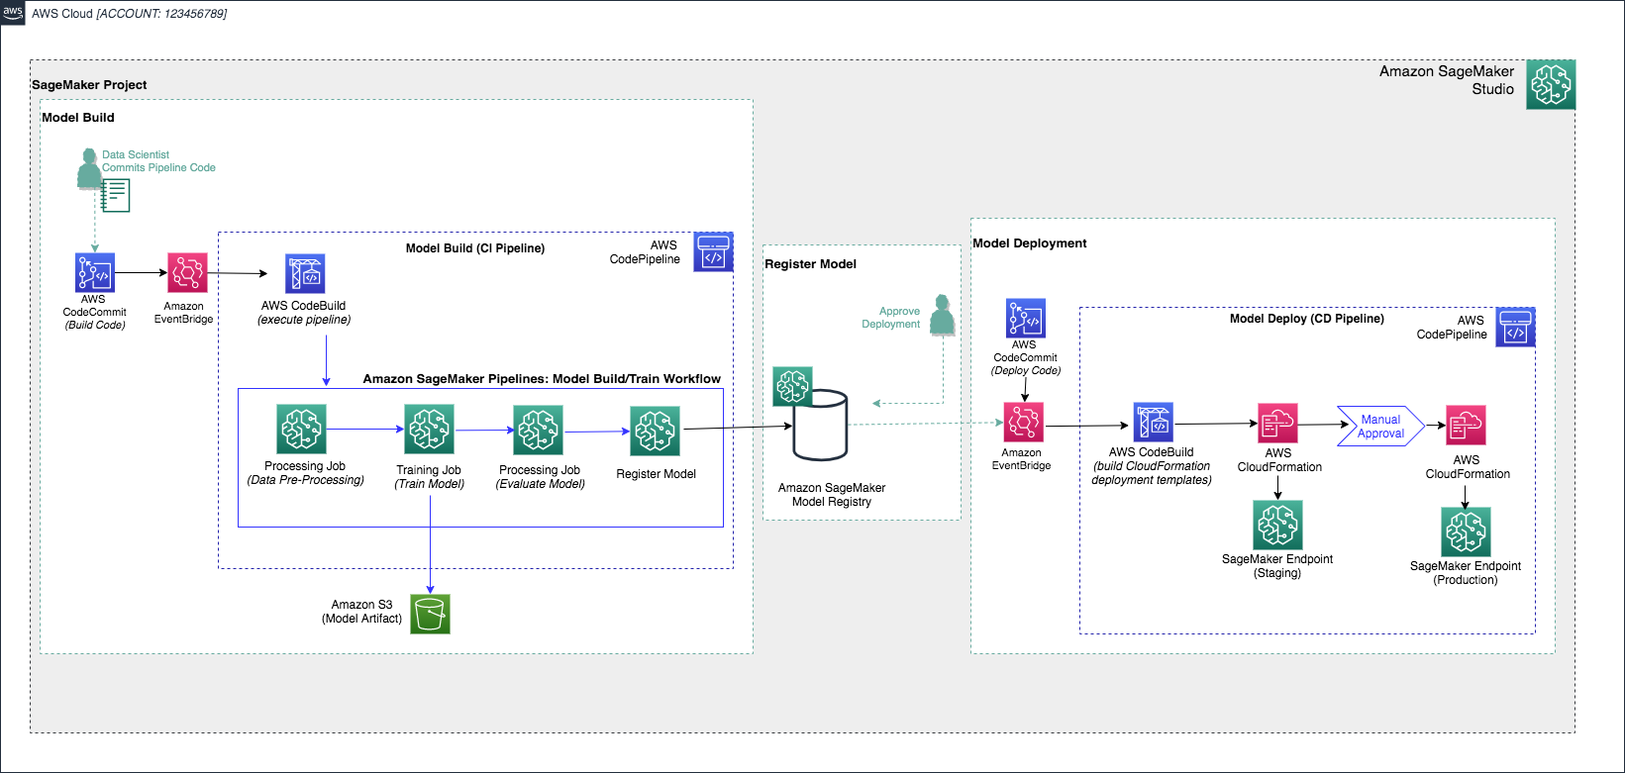
Amazon SageMaker Pipelines - Projects
High Level Services View
Build, Train, Deploy Template
101

Slide 102
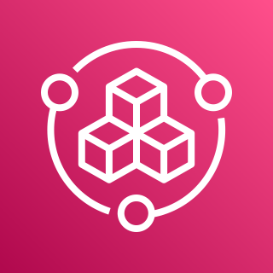
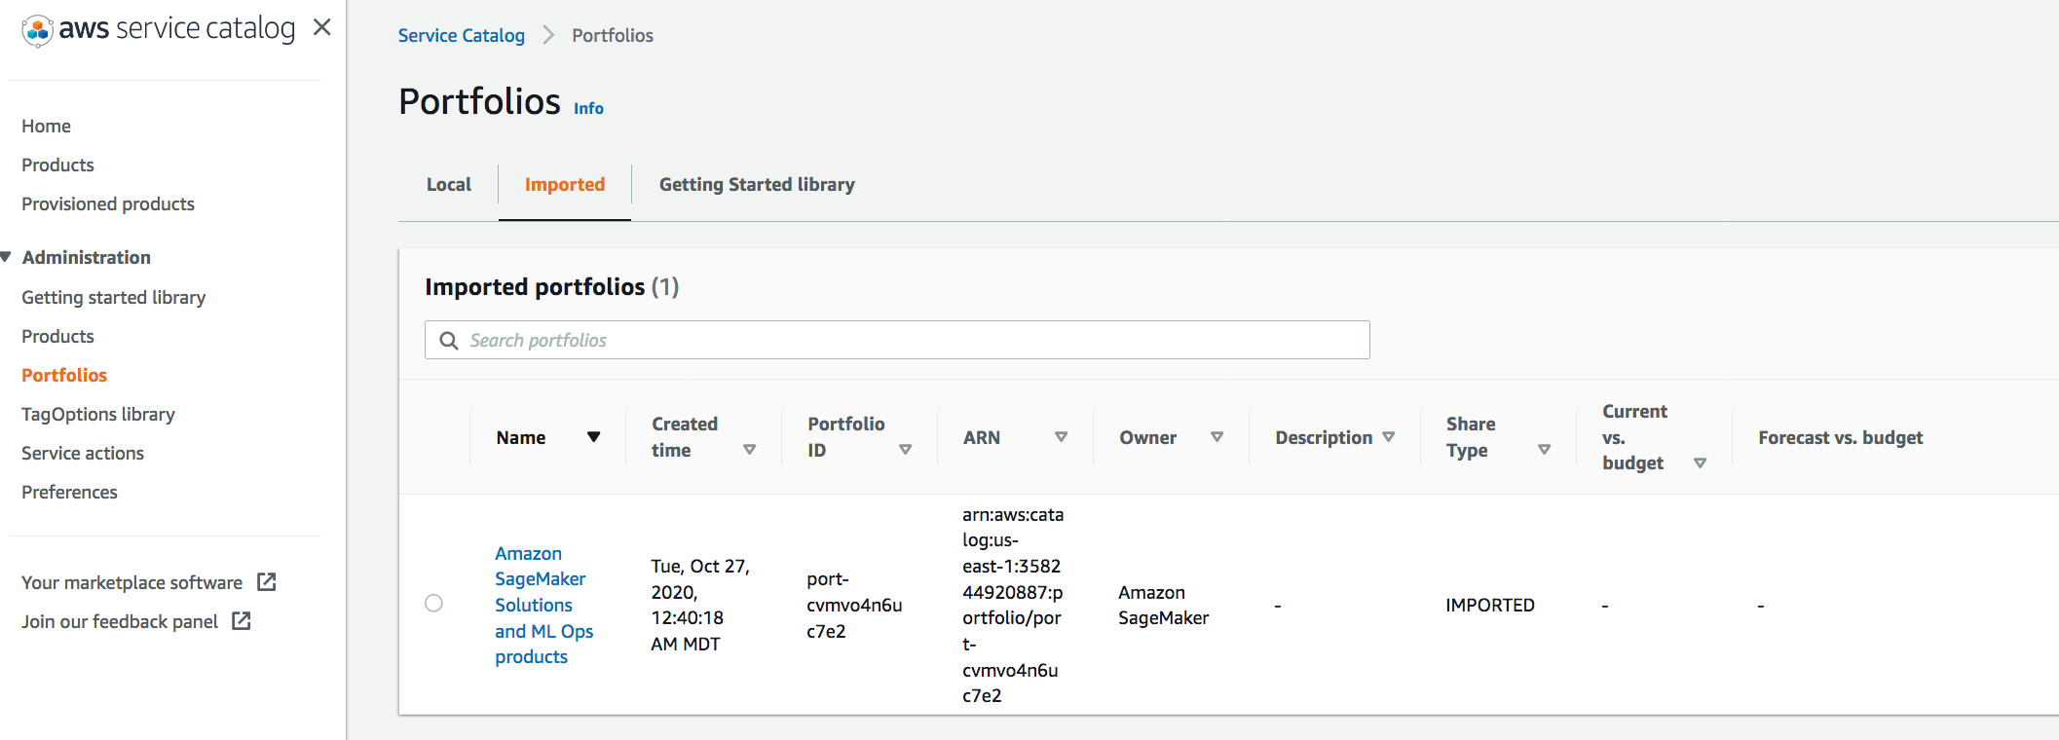
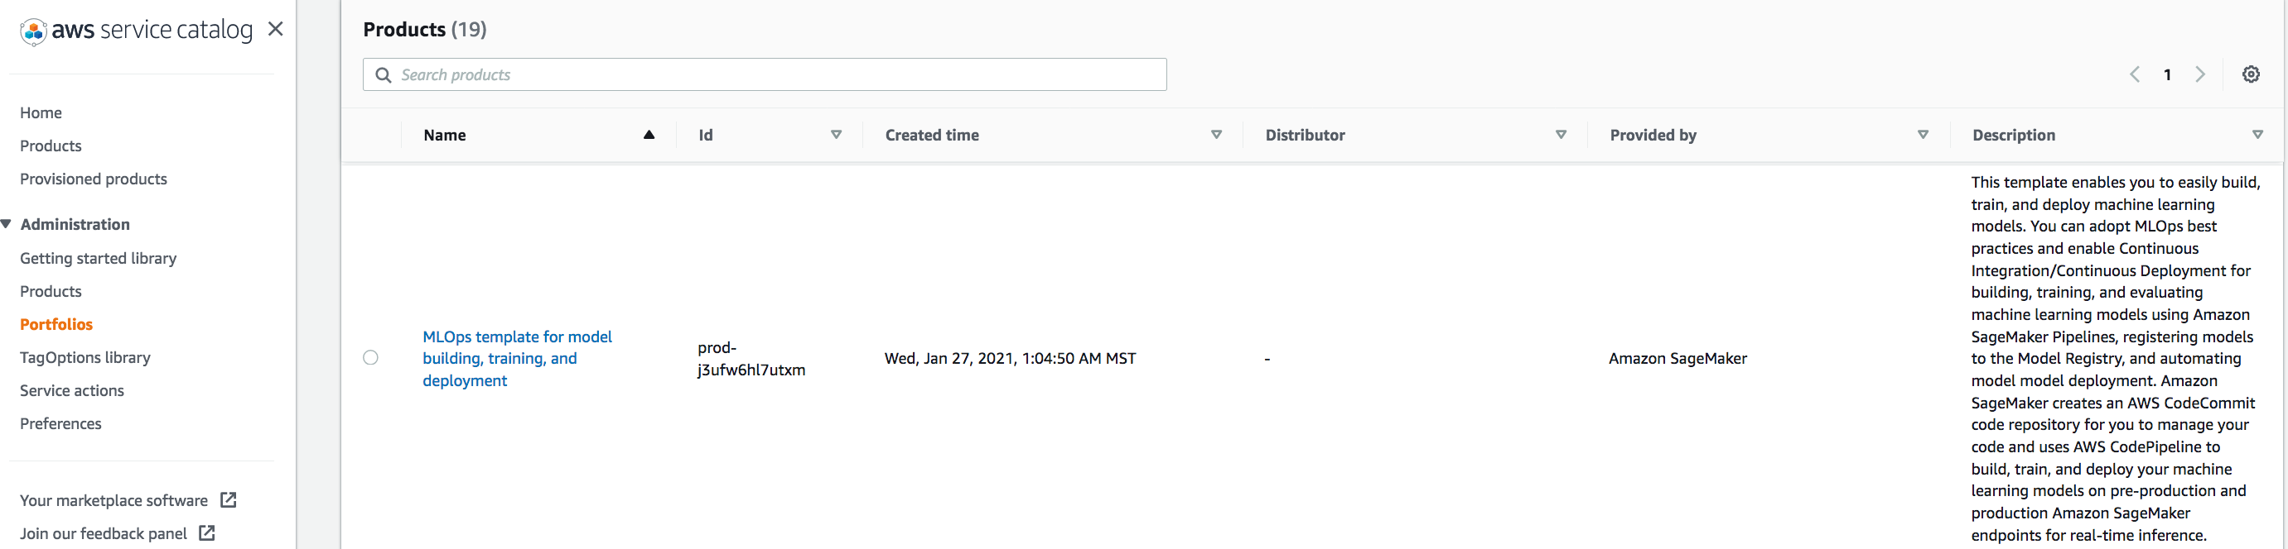
Amazon SageMaker Pipelines - Projects
Underlying Services
Built-In Project templates are offered through Products contained in a managed AWS Service Catalog Portfolio
AWS Service Catalog
Description: AWS Service Catalog allows organizations to create and manage catalogs of IT services that are approved for use on AWS.
102

Slide 103

Amazon SageMaker Pipelines - Projects
Underlying Services
SageMaker Pipelines uses AWS CloudFormation to provision & configure:
Project resources needed to build an end-to-end pipeline
Model endpoint deployments for an instantiated Project
AWS CloudFormation
Description: AWS CloudFormation templates allow for the ability to consistently provision, configure, and manage resources using Infrastructure-as-Code
103

Slide 104
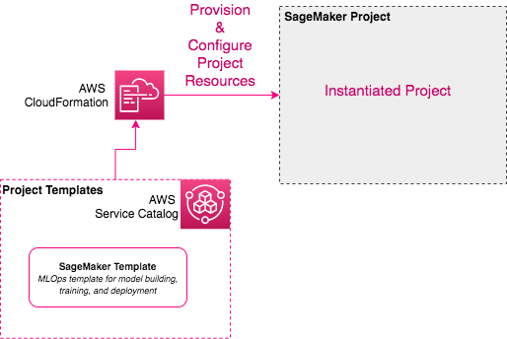
Amazon SageMaker Pipelines - Projects
Underlying Services
AWS
CloudFormation
Project resources needed to build an end-to-end pipeline
104

Slide 105

Amazon SageMaker Pipelines - Projects
Underlying Services
SageMaker Pipelines uses AWS CodePipeline to orchestrate model build and model deploy activities:
Model Build
Model endpoint deployments for an instantiated Project
AWS CodePipeline
Description: AWS CodePipeline is a fully managed Continuous Delivery (CD) service
105

Slide 106
Amazon SageMaker Pipelines - Projects
Features
Utilize Built-In MLOps Project Templates:
Build, Train, Deploy
Build, Train
Deploy
Create Custom MLOps Project Templates
106

Slide 107


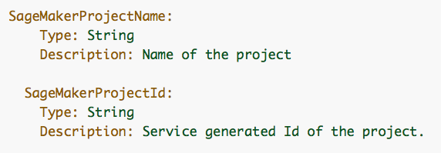

Amazon SageMaker Pipelines - Projects
Building Custom Templates
1. Create Your Custom Template
2. Upload CloudFormation Template to S3
AWS
CloudFormation
Amazon S3
Required parameters to include:
Tip: Use the SageMaker built-in templates as a starting point
107
Notes:
If the SageMaker provided templates do not meet your needs (for example, you want to have more complex orchestration in the CodePipeline with multiple stages, custom approval steps, etc.) create your own templates.
We recommend starting by using SageMaker provided templates to understand how to organize your code and resources and build on top of it. To do this, after you enable administrator access to the SageMaker templates, login to thehttps://console.aws.amazon.com/servicecatalog/, choose Portfolios, then choose Imported. For information about AWS Service Catalog, see Overview of AWS Service Catalog in the AWS Service Catalog User Guide.
Create portfolio (or add to existing)

Slide 108
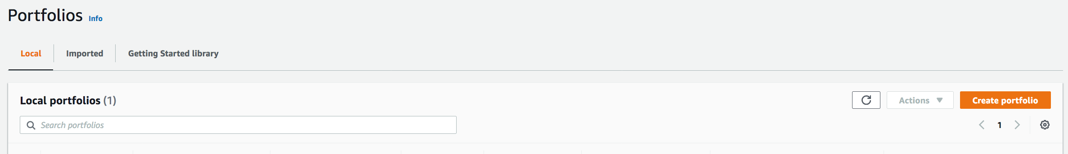
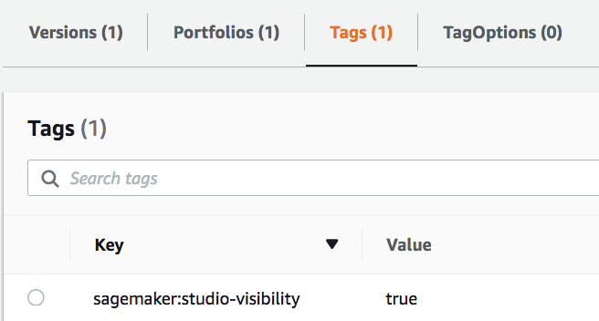
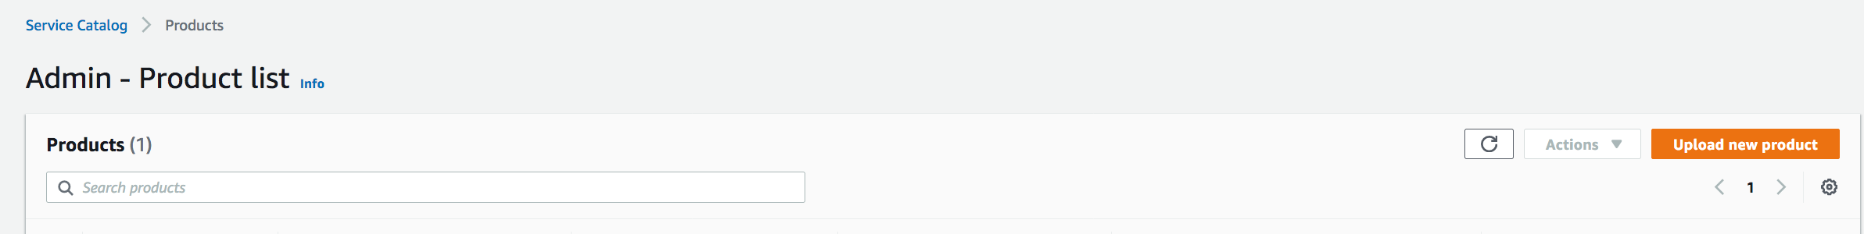
Amazon SageMaker Pipelines - Projects
Building Custom Templates
AWS
Service Catalog
Service Catalog Tasks
3. Create Portfolio
4. Create Product
Required Tags
Your template will now be available for use in SageMaker Studio!
108
Notes:
https://docs.aws.amazon.com/sagemaker/latest/dg/sagemaker-projects-templates-custom.htmlhttps://docs.aws.amazon.com/sagemaker/latest/dg/sagemaker-projects-templates-custom.html
Create portfolio (or add to existing)
To make your project template available in your Organization templates list in SageMaker Studio, create a tag with the following key and value to the Service Catalog Product you created in step 2.
key - sagemaker:studio-visibility
value - true
After you complete these steps, SageMaker Studio users in your organization can create a project with the template you created by following the steps in Create an MLOps Project and choosing Organization templates when you choose a template.

Slide 109
Amazon SageMaker
Next Steps
Onboarding & Processing
Training
Deployment
https://docs.aws.amazon.com/sagemaker/latest/dg/gs-studio-onboard.html
https://docs.aws.amazon.com/sagemaker/latest/dg/processing-job.html
https://docs.aws.amazon.com/sagemaker/latest/dg/train-model.html
https://docs.aws.amazon.com/sagemaker/latest/dg/distributed-training.html
https://aws.amazon.com/sagemaker/debugger
https://docs.aws.amazon.com/sagemaker/latest/dg/realtime-endpoints.html
https://docs.aws.amazon.com/sagemaker/latest/dg/serverless-endpoints.html
https://docs.aws.amazon.com/sagemaker/latest/dg/async-inference.html
https://docs.aws.amazon.com/sagemaker/latest/dg/batch-transform.html
https://github.com/aws/amazon-sagemaker-examples
https://sagemaker.readthedocs.io/en/stable/index.html
109
Notes:
You can get started with SageMaker in a matter of minutes. Select the right entry path based on your role.

